Slide 1
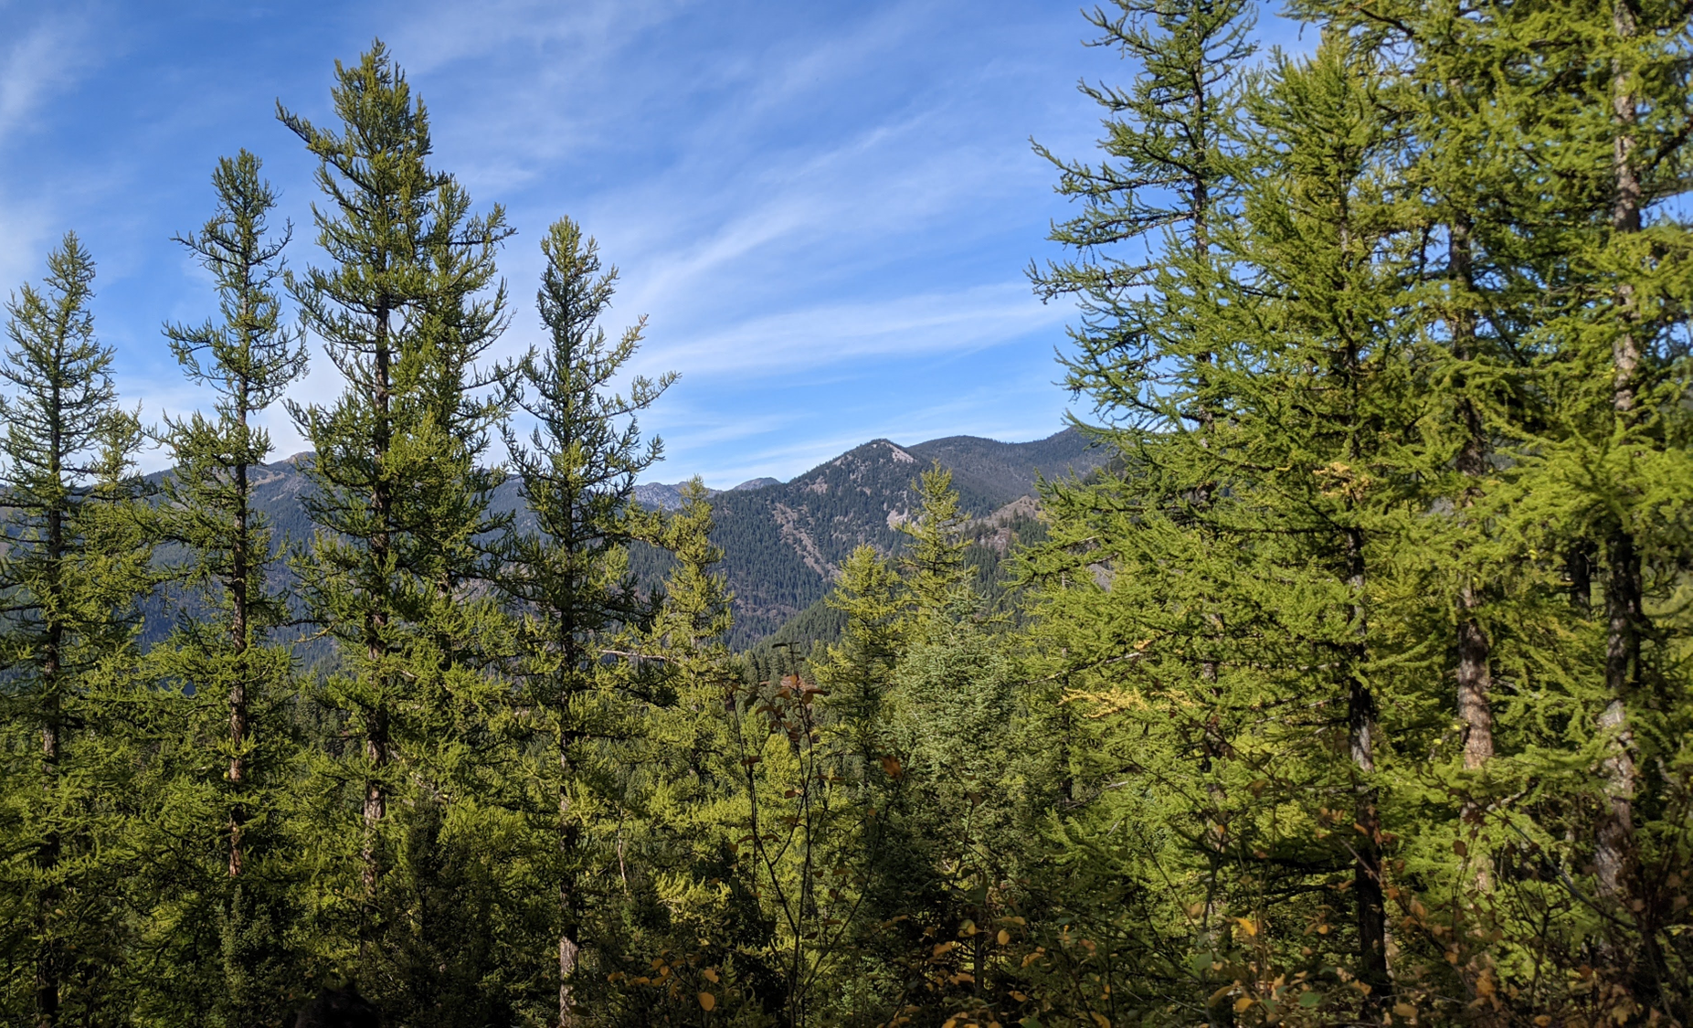
Evaluating the effects of forest community composition on western larch growth
Christian Mercado
Committee: David Affleck, Andrew Larson, Justin Crotteau, David Patterson
University of Montana, Missoula, MT, USA
Notes:
Western larch (Larix occidentalis) is a deciduous conifer that grows exclusively within the inland northwestern region of North America.
It is akin to Larix laricina, or eastern larch, however unlike its eastern counterpart, western larch holds considerable timber value.
It generally grows tall and straight and can grow to large diameters with heights well over 100 feet. its lumber is mixed with that of douglas-fir, which speaks to its value.
Western larch grows across elevations and conditions from valley bottoms to ridgetops.
It is also very intolerant of shade, has thick bark, and establishes prolifically after fire in mineral soil, making it both fire resistant and resilient.

Slide 2
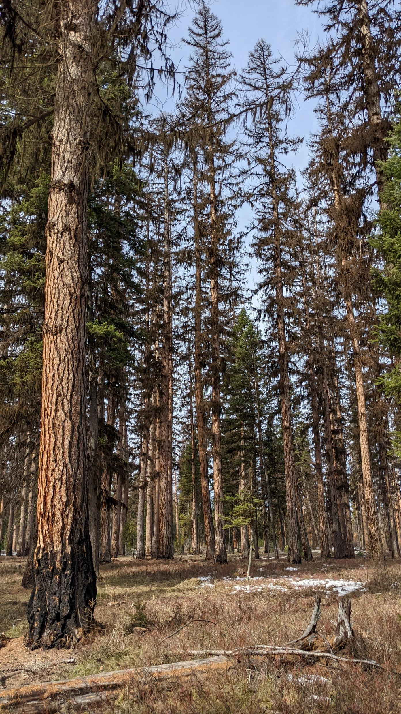
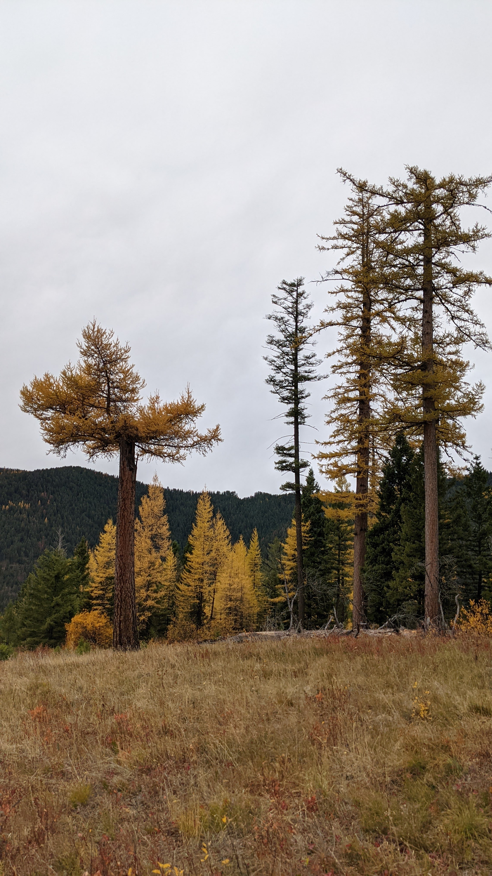
Larix occidentalis – Western larch
Notes:
Western larch (Larix occidentalis) is a deciduous conifer that grows exclusively within the inland northwestern region of North America. It is akin to Larix laricina, or eastern larch, however unlike its eastern counterpart, western larch holds considerable timber value. It generally grows tall and straight and can grow to large diameters with heights well over 100 feet. its lumber is mixed with that of douglas-fir.
Western larch grows at various elevations, spanning across subalpine environments.
It is also very intolerant of shade, has thick bark, and establishes prolifically after fire in mineral soil, making it both fire resistant and resilient.

Slide 3
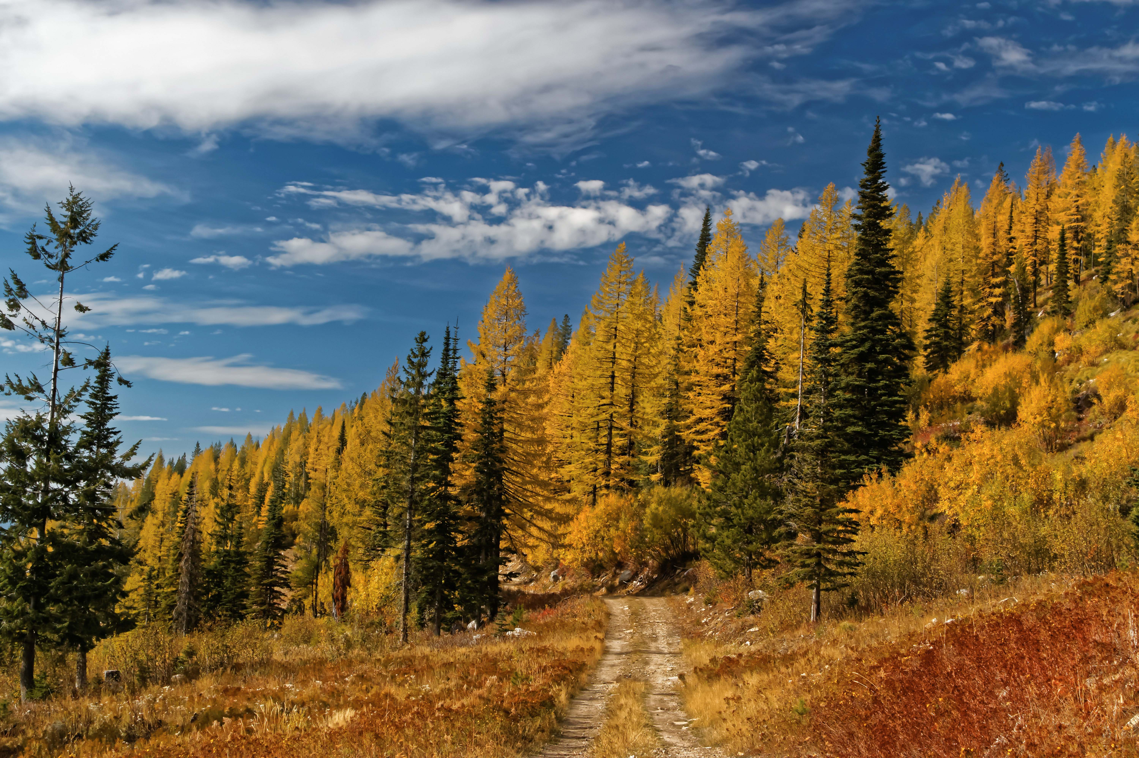
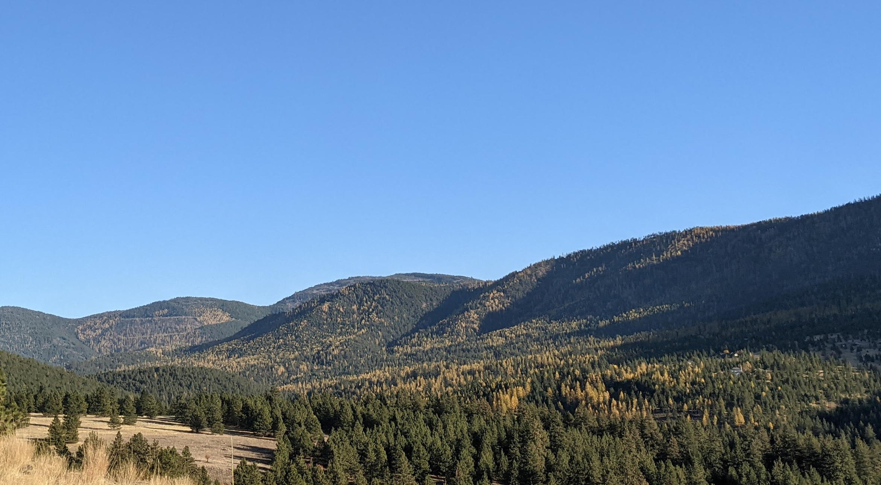
Larix occidentalis – Western larch
Shade intolerant
W. Larch
Lodgepole pine
Ponderosa pine
White pine
Douglas-fir
Grand fir
Subalpine fir
Engelmann spruce
W. Redcedar
W. Hemlock
Pacific yew
Shade tolerant
Notes:
Sometimes managed in plantations with only larch, but since management in this region is not very intensive, it oftentimes is managed with other species.
Those species are shown on the right by order of shade tolerance, where on top are shade intolerant trees like larches and pines, and on the bottom there are trees that thrive in the shade, like fir, spruce, and hemlock.
In the photo on the left, larch are the yellow trees, others are green.
In mixed-species forests like this one, different species fill different ecological niches. That is, each species has its own methods in which it acquires resources that it needs to grow.
Naturally, trees compete for water, light, and nutrients in a stand like this, especially when two species fill the same niche.
However, recent research has suggested that the ecological niches which two species occupy in a stand might actually be complementary of one another, meaning that the way that two species acquire or use resources can lead to less competition for those resources compared to when trees of the same species or that fill the same niche grow with one another.
In other words, niche complementarity among species can lead to competitive reduction in mixed-species stands.
Since competition may be reduced when there is niche complentarity among species in a stand, one might expect that growth of trees in that stand could be higher than trees of the same species in a different stand where niche complementarity is not present.
In fact, various studies have shown that growth and yield can be effected by species-mixing, but very few studies of this nature have been conducted in western north America.
Additionally, quantifying species niche can be somewhat difficult, so examining niche complementarity effects on growth requires investigation.
Since shade tolerance relates to how a tree acquires or uses light, it may be used to describe its light-seeking niche as well.
So, in theory when shade-intolerant western larch grows with more shade tolerant firs and spruces, one might expect to see less competition for light compared to when larch is growing with larch or other shade-intolerant species.

Slide 4
Question:
How does community composition impact the growth of western larch?
Expectation:
W. Larch would have higher growth when growing with shade-tolerant species
Notes:
Provided with this information, my primary research question was:
How does community composition impact the growth of western larch?
Given the hypothesis that that shade tolerance accounts for species light-use niche and that niche complementarity modifies growth through competitive reduction, my expectation was that, even after accounting for other competitive effects, western larch would experience higher rates of growth when mixed with species that are more shade-tolerant than it

Slide 5
Questions
After accounting for other factors, how does community composition impact the growth of western larch?
How can species-mixing effects be captured within an individual tree growth model?
Notes:
Provided with this information, my primary questions were:
How does community composition impact the growth of western larch once all other influencing factors are accounted for?
And
How can the effects of species-mixing on growth best be captured within an empirical individual-tree growth model?

Slide 6
Objectives
Describe how W. Larch growth varies with tree size, competition, density, and site productivity.
Identify if these effects on growth differ between mixtures and pure larch conditions
Compare different measures of species-mixing as predictors of growth
Notes:
The associated objectives were then to
First, describe how western larch growth varies with tree size, competition, stand density, and site productivity. These things are known to explain variation in tree growth already, but they do not address interspecific dynamics.
Once these effects were captured, and in order to address community composition effects on growth, my second objective then was to see if these growth effects varied when western larch was growing with other species, compared to when it was growing with other larch.
Now it’s one thing if growth effects vary across mixtures, but if it does, there ought to be a way to capture that effect after accounting for these other effects.
So, my third objective was to compare different variables that represent species-mixing after accounting for size, competition, and site effects on growth.
That way I could specifically address if shade-tolerance (for example) has an important effect on growth after accounting for these other effects.

Slide 7
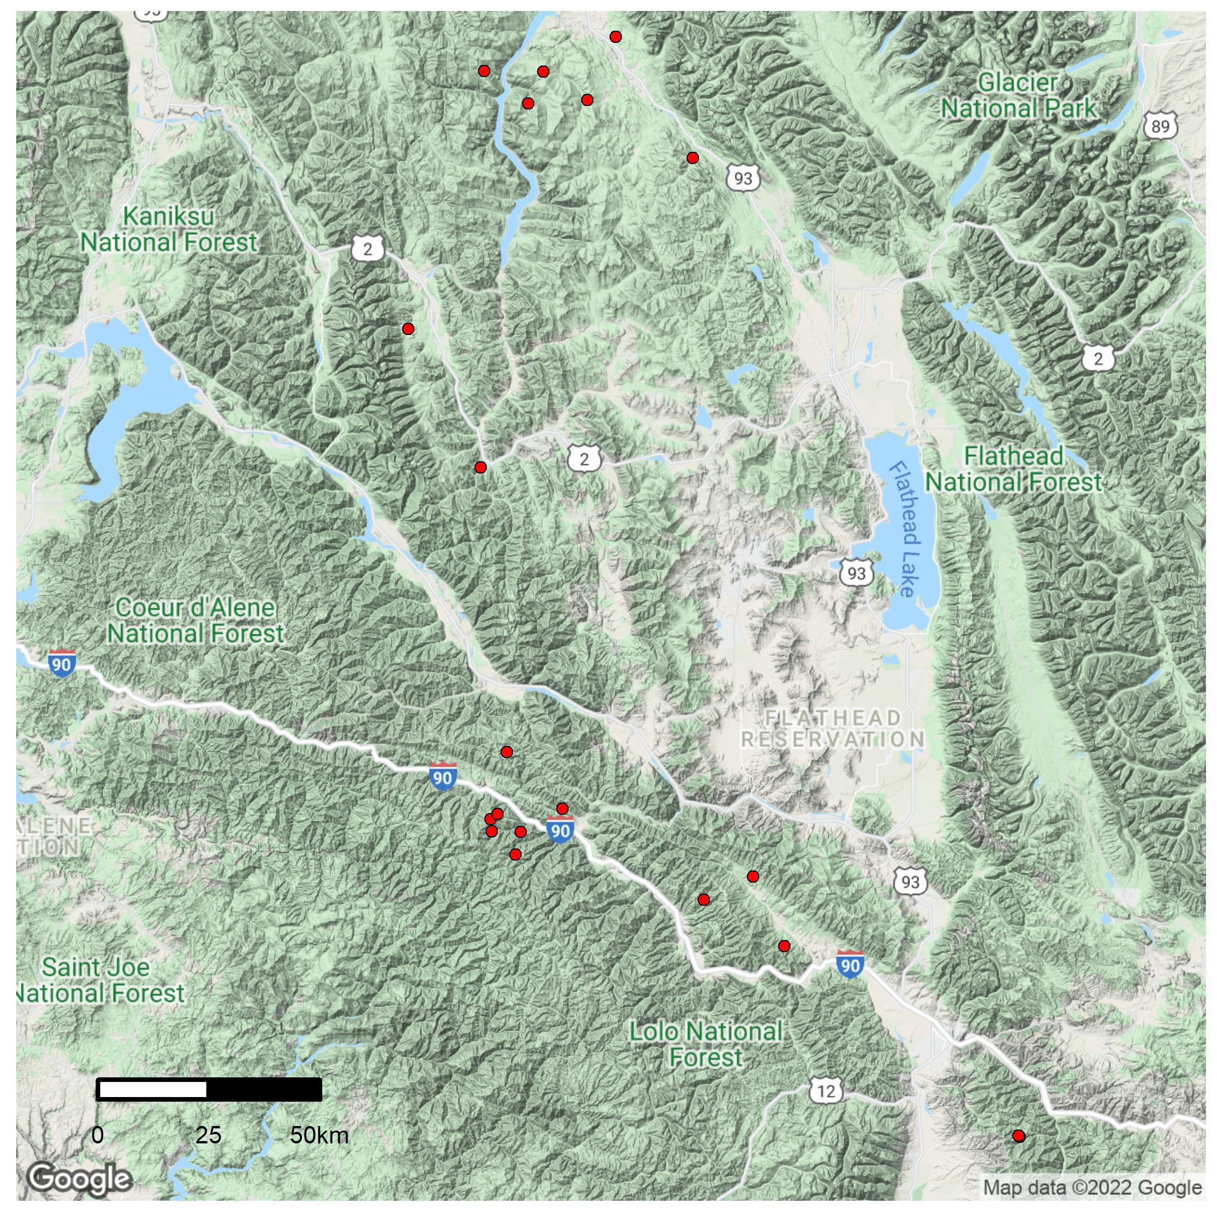
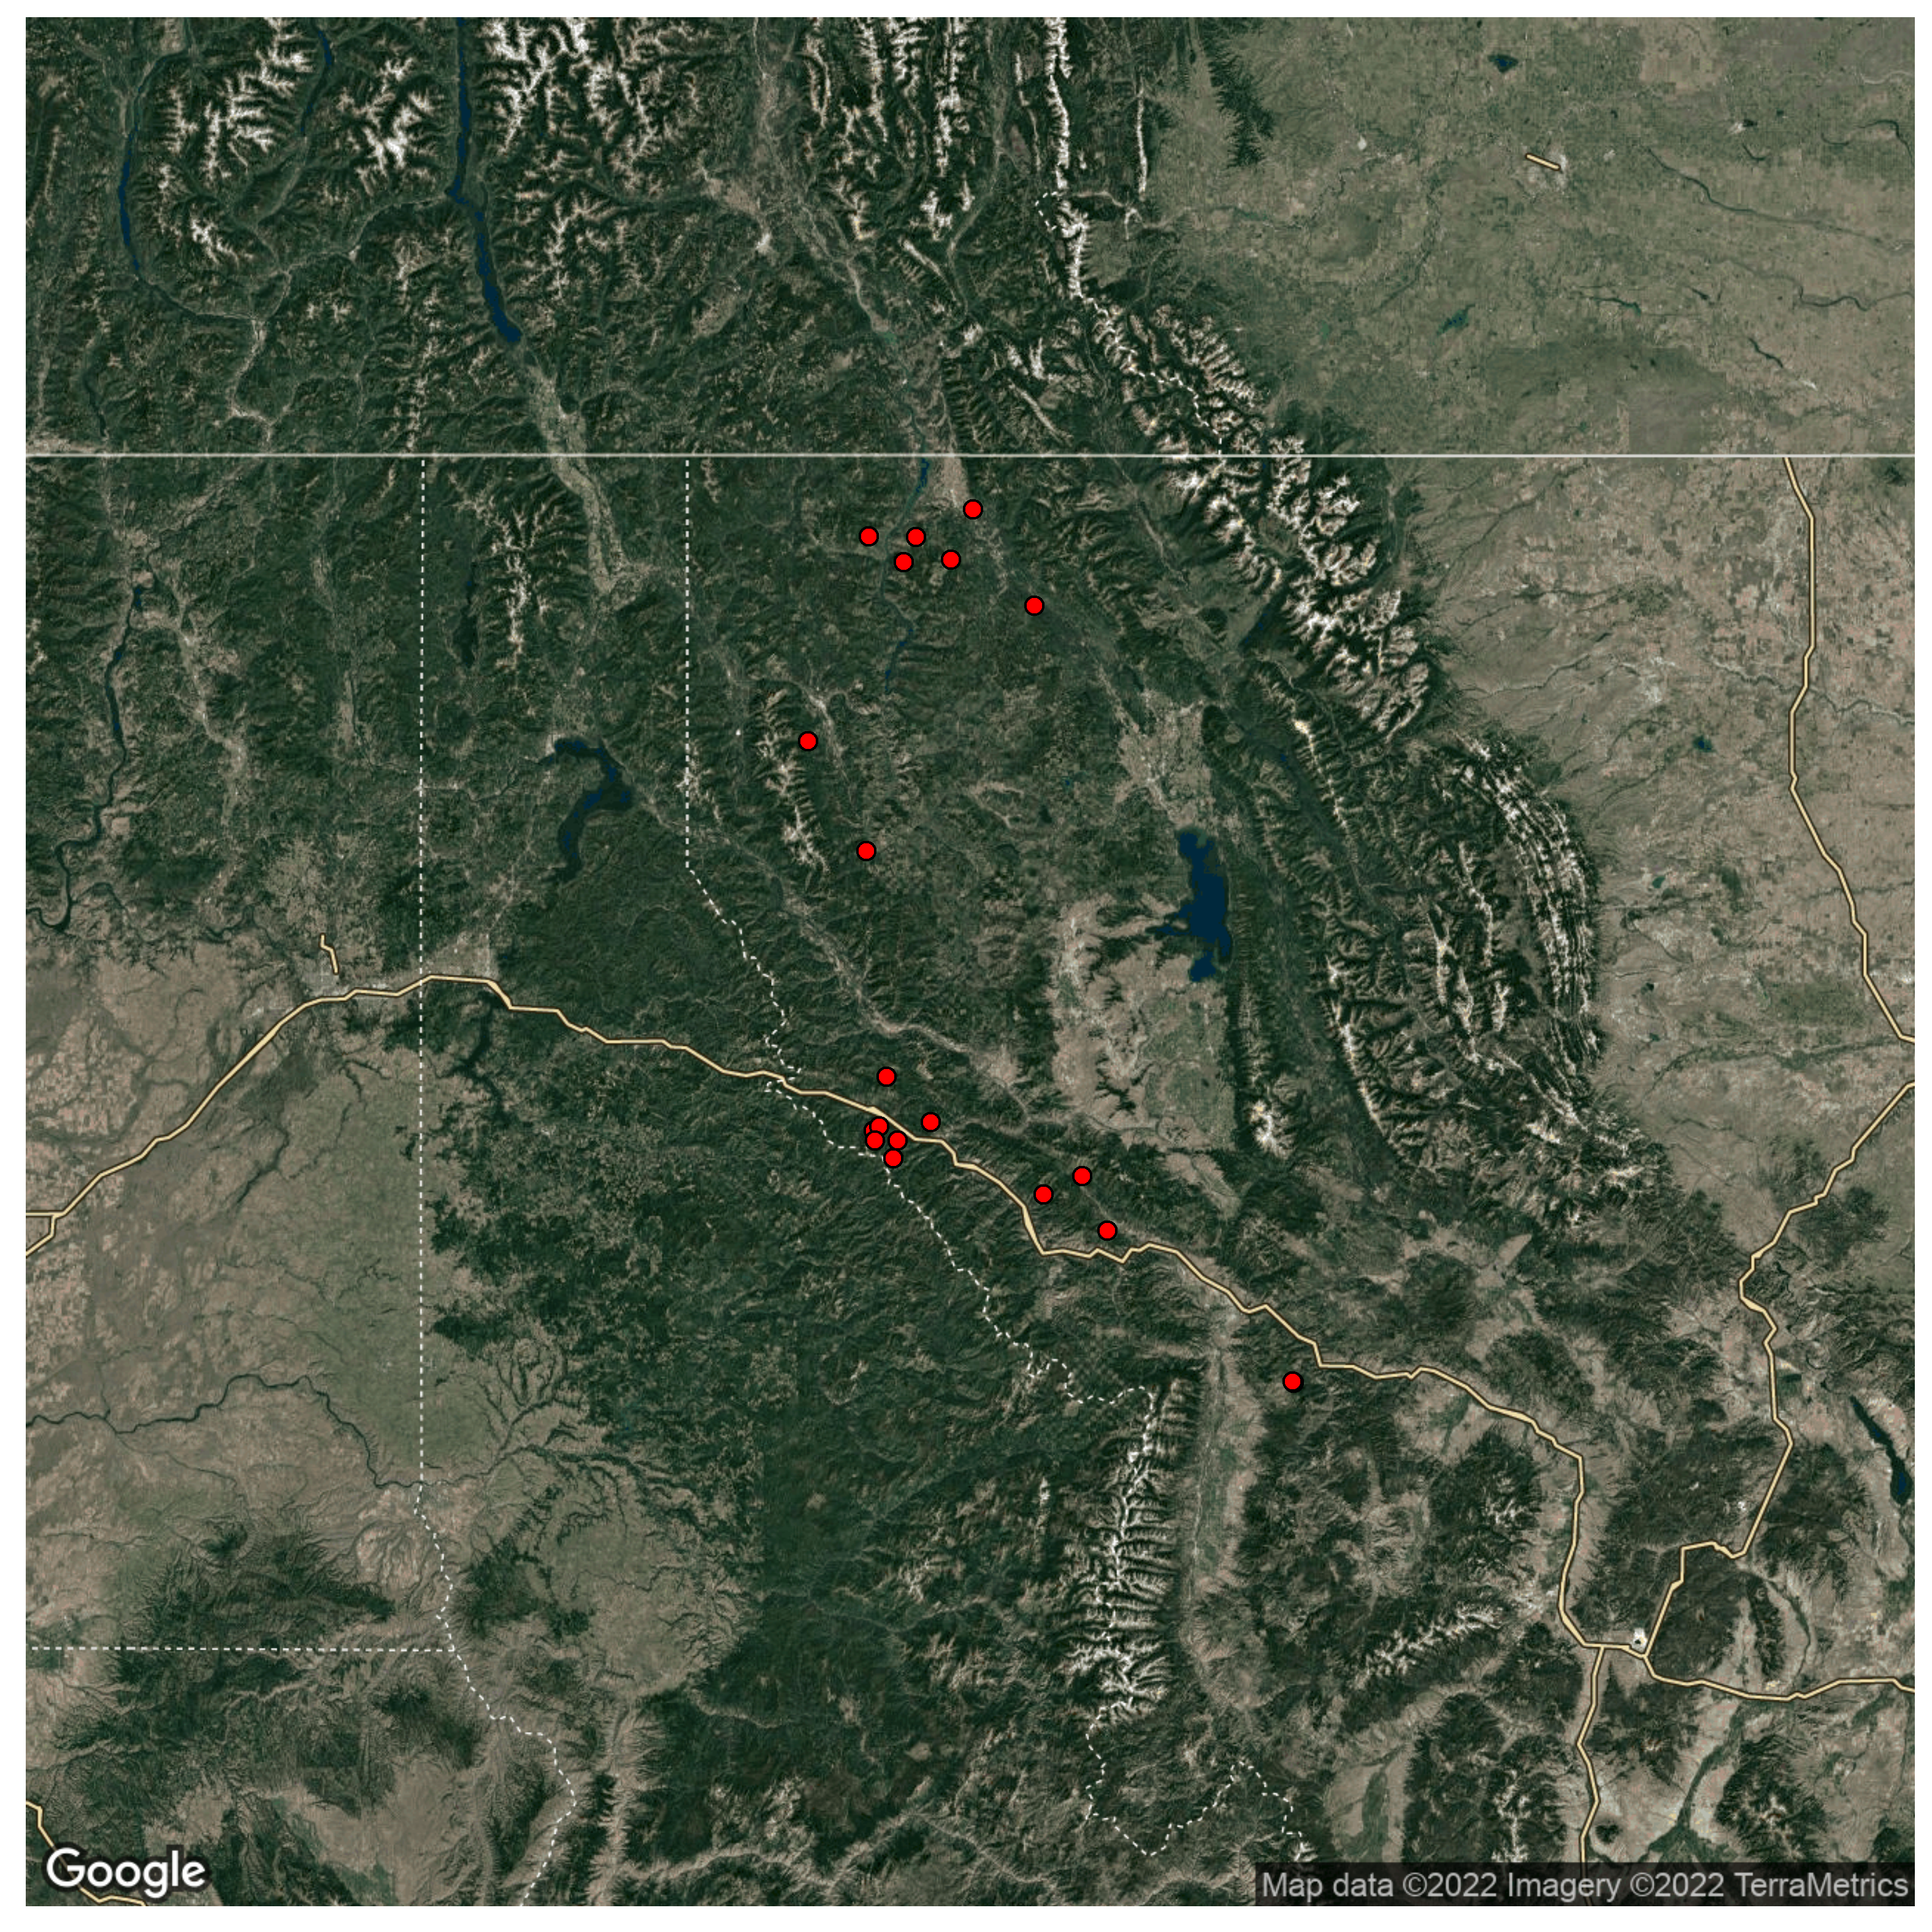
Tree growth data
Permanent Growth Plots
18 stands on 2 National Forests in Montana
Various attributes collected (DBH, HT., etc.)
Canada
USA
Montana
Washington
Idaho
Missoula
Notes:
To describe how western larch growth varies, I used a data set that consists of repeat-measurements on trees in various stands on national forest lands that were initially measured in the 1980’s. The locations of theses stands were throughout the northwestern corner of Montana, as shown by red dots on the map.
Each of these stands were measured 4 or 5 times between 1980 and 2021 and the time between measurements was highly irregular throughout this period.
These stands are a subset of a much larger data set that spans the inland northwest.
Data collection occurred on these stands in 2021 specifically because they had a high proportion of western larch at the most recent measurement.

Slide 8
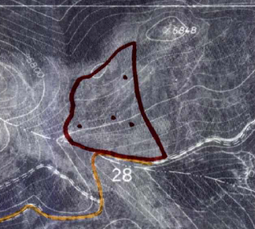
Tree growth data
Permanent Growth Plots
18 stands on 2 National Forests in Montana
Various attributes collected (DBH, HT., etc.)
Canada
USA
Montana
Washington
Idaho
Missoula
Notes:
These stands consist of 4 plot clusters that were randomly located within a stand, as shown by black dots on the hand-drawn stand map.
Each stand was treated with thinning, where three plot clusters were thinned, and the fourth was left as an un-thinned control plot, providing a side-by-side comparison of growth between thinned-and-unthinned conditions at the same site.

Slide 9
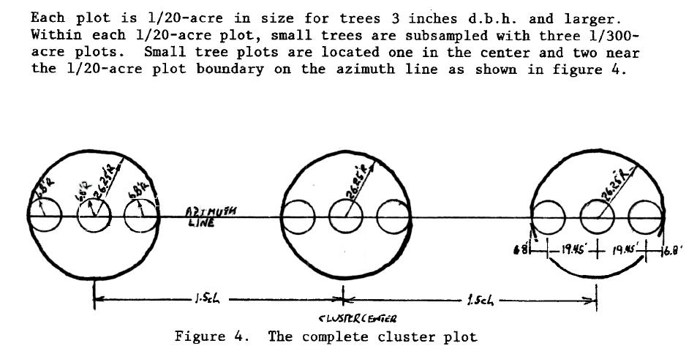
Tree growth data
Permanent Growth Plots
18 stands on 2 National Forests in Montana
Various attributes collected (DBH, HT., etc.)
Canada
USA
Montana
Washington
Idaho
Missoula
Notes:
Each cluster contains 3 sample plots where data was collected on large-trees, and each of those plots contains 3 sub-plots, where data was collected on small trees.
The figure on the top right shows what a plot cluster looks like, where the large circles are large tree plots, and the small-tree plots are nested within those larger plots, shown by the smaller circles.
Large and small plots were a fixed area, representing 1/20th of an acre and 1/300th of an acre, respectively.
Within the large-tree plots, data such as: DBH, height, crown ratio, as well as biotic and abiotic damage data were collected on trees larger than an established diameter threshold.
Large trees were tagged at the time of initial measurement so that they’re data could be linked over time between measurements.
At subsequent measurements, trees that grew above the diameter threshold since the previous measurement were tagged and added to the data set as large-trees for remeasurement.
Within the small-tree sub-plots, trees were tallied by species and height, and DBH was measured on trees taller than 4.5 feet, but that had diameters smaller than the threshold.
In both small and large tree plots, trees were counted as live or dead, providing information on tree mortality over time as well.
Additionally, GPS points were taken at each cluster of plots. These GPS points were plugged into google earth engine, and terrain characteristics were extracted, such as slope, aspect, elevation, and heatload.
Since I was interested in tree growth, I only used data on trees that were alive.
Tree growth was calculated with basal area increment, which I will define in a moment.
Data was collected on trees of every species, but in these analyses, growth was only assessed on western larch since that was the species of interest.
From here, I’ll describe my analysis

Slide 10
Tree growth data
Permanent Growth Plots
18 stands on 2 National Forests in Montana
Various attributes collected (DBH, HT., etc.)
Canada
USA
Montana
Washington
Idaho
Missoula
Notes:
To describe how western larch growth varies, I used a data set that consists of repeat-measurements on trees in various stands on national forest lands that were initially measured in the 1980’s. The locations of theses stands were throughout the northwestern corner of Montana, as shown by red dots on the map.
Each of these stands were measured 4 or 5 times between 1980 and 2021 and the time between measurements was highly irregular throughout this period.
These stands are a subset of a much larger data set that spans the inland northwest.
Data collection occurred on these stands in 2021 specifically because they had a high proportion of western larch at the most recent measurement.
These stands consist of 4 plot clusters that were randomly located within a stand, as shown by black dots on the hand-drawn stand map. Each stand was treated with thinning, where three plot clusters were thinned, and the fourth was left as an un-thinned control plot, providing a side-by-side comparison of growth between thinned-and-unthinned conditions at the same site.
Each cluster contains 3 sample plots where data was collected on large-trees, and each of those plots contains 3 sub-plots, where data was collected on small trees.
Within the large-tree plots, DBH, height, crown ratio, as well as biotic and abiotic damage data were collected on trees larger than an established diameter threshold. Since it takes a while to measure tree heights,
height was only measured a subset of large trees within each plot.
Large trees were tagged at the time of initial measurement so that they could be tracked over time.
At subsequent measurements, trees that grew above the diameter threshold since the previous measurement were tagged and added to the data set as large-trees for remeasurement.
Within the small-tree sub-plots, trees were tallied by species and height, and DBH was measured on trees taller than 4.5 feet, but that had diameters smaller than the threshold.
In both small and large tree plots, trees were counted as live or dead, providing information on tree mortality over time as well.
Additionally, GPS points were taken at each cluster of plots. These GPS points were plugged into google earth engine, and terrain characteristics were extracted, such as slope, aspect, elevation, and heatload.
Since I was interested in tree growth, I only used data on trees that were alive.
Tree growth was calculated with basal area increment, which I will define in a moment.
Data was collected on trees of every species, but growth was only assessed on western larch.
All models were informed by a long-term data set which consists of repeat measurements on trees within 18 forest stands in northwestern Montana.
The map here shows the rough locations of study areas used, where each dot represents a stand. Site conditions like slope, aspect, and elevation were variable across stands in the data set.
These data are part of a larger network of permanent growth plots (or PGP’s) that were installed in the 1980’s to monitor tree growth in response to thinning.
Given this, each stand contained 4 plot clusters, 3 were treated with thinning (precommercial thinning) and 1 was left un-thinned as a control.
Trees within plots were tagged and measured about 40 years ago, and subsequent remeasurements on the same trees (and new trees) were taken at varying increments of time since then.
In 2021 I led a crew of 3 to conduct re-measurements on these 18 stands. We chose to re-measure these stands because they had a high presence of western larch data in them.
The photo on the right shows the center of a control plot that is nearly pure western larch.
Various attributes were collected on trees, including DBH, height, crown class, crown ratio, tree biotic and abiotic damage, and other info.
Each stand was measured 4 or 5 times over the last 40 years.

Slide 11
Objectives
Describe how W. Larch growth varies with tree size, competition, density, and site productivity.
Identify if these effects on growth differ between mixtures and pure larch conditions
Compare different measures of species-mixing as predictors of growth
Notes:
I’ll show you how each objective was accomplished in the order shown.
I’ll come back to this slide after I explain each objective to remind you where we’re at.
Since objectives 2 and 3 depend on the outcome of the first objective, we’ll start there.

Slide 12
Growth effects
Annual growth- Basal area increment (BAI)
Size, Competition, and Site effects
Generalized Additive Mixed Model (GAMM) approach
$ln⁡(BAI)=f_{1}\left(Size\right)+f_{2}\left(Competition\right)+f_{3}\left(Site\right)$ + RE
Notes:
Growth was quantified by annual basal area increment, which is the annual change of a tree’s stem area per year. This measure was annualized because of the varying periods of time between measurements.
Since I was only interested in live-tree growth, I only used BAI values that were greater than zero
BAI cannot be negative, and thus is bound by zero.

Slide 13
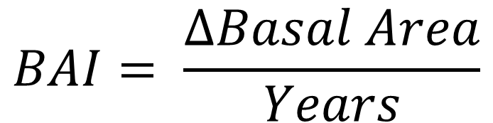
Characterizing growth
Annualized Basal Area Increment (BAI)
Size, Competition, and Site effects
Generalized Additive Mixed Model (GAMM) approach
$$BAI= \frac{∆Basal Area}{Years}$$
Notes:
Growth was quantified by annual basal area increment, which is the annual change of a tree’s stem area per year.
(Draw on board)
This measure was annualized because of the varying periods of time between measurements.
Since I was only interested in live-tree growth, I only used BAI values that were greater than zero
BAI cannot be negative, and thus is bound by zero.

Slide 14
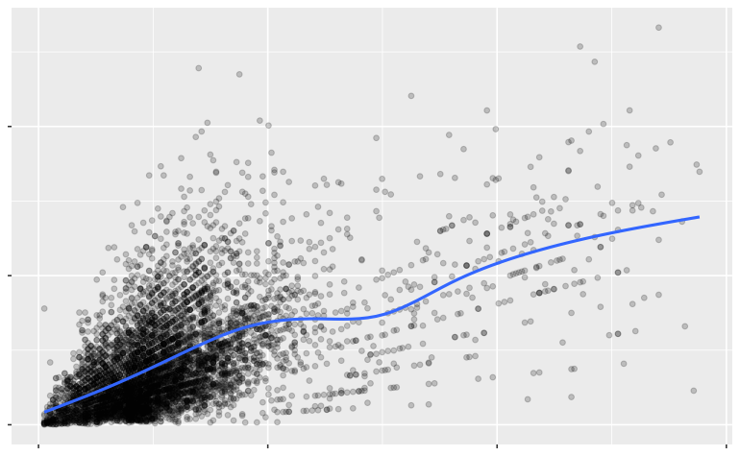
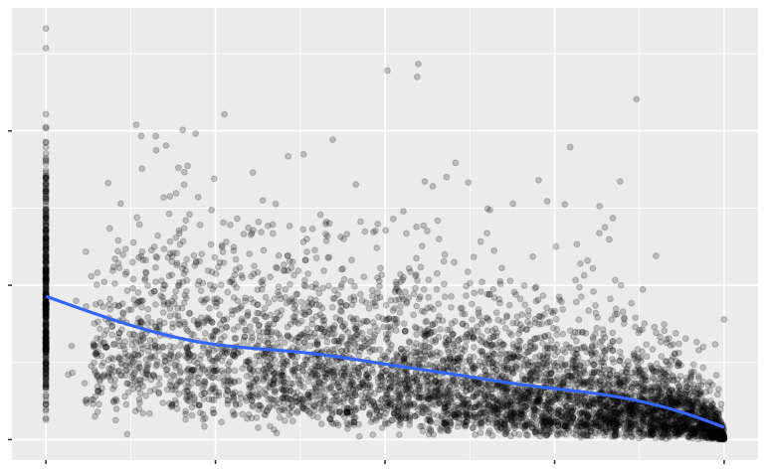
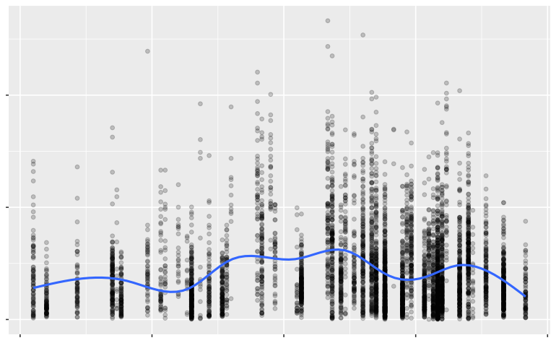
Characterizing growth
Annual growth- Basal area increment (BAI)
Size, Competition, and Site effects
Generalized Additive Mixed Model (GAMM) approach
$\ln\left(BAI\right)={ f}_{1}\left(Size\right)+f_{2}\left(Competition\right)+f_{3}\left(Site\right)$ + RE
BAI
BAI
BAI
DBH
BAL
Heatload
Notes:
I used a model to capture The effects of size, competition, and site on growth. The model looks like this equation shown, where BAI depends on a combination of some function of size, competition, and site effects.
Each figure below shows BAI on the y-axis, plotted against a size variable in the left figure, a competition variable in the middle, and a site variable on the right. A smooth line was added to each plot to visualize trends in the data points.
Notice that each smooth line is not perfectly straight, and that the distribution of BAI at any given point on each x-axis is non necessarily constant across different points on the x-axes.
For example, in the figure on the left, a smaller sized tree has a limited potential range of BAI values, whereas a larger tree has wide range of BAI values. This can pose a challenge in traditional modeling approaches
Also, since BAI is bound by zero at the low end, we can see a clumping of data at low values,

Slide 15
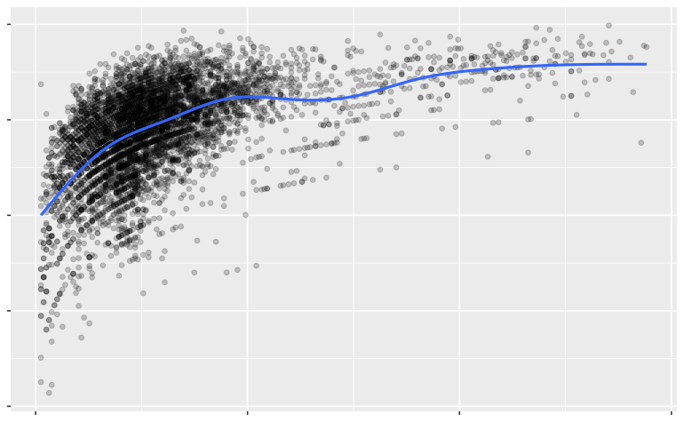
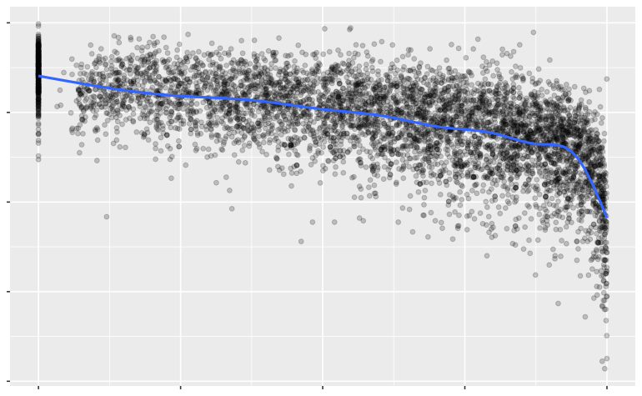
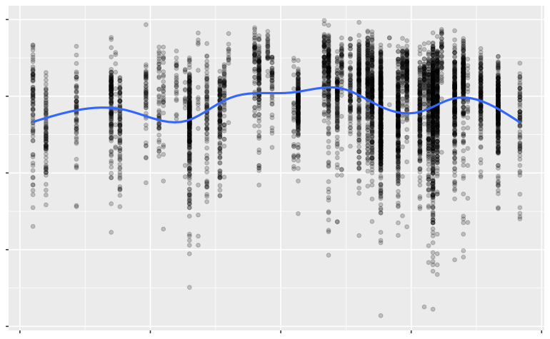
Characterizing growth
Annual growth- Basal area increment (BAI)
Size, Competition, and Site effects
Generalized Additive Mixed Model (GAMM) approach
$\ln\left(BAI\right)={ f}_{1}\left(Size\right)+f_{2}\left(Competition\right)+f_{3}\left(Site\right)+tree$ + RE
ln(BAI)
ln(BAI)
ln(BAI)
DBH
BAL
Heatload
Notes:
To accommodate these types of characteristics, BAI is typically modelled with a natural log transformation, as shown in the updated equation.
Each of the figures are now shown with the natural log of BAI on the y-axis. As you can see, the points are less clumped at lower values of BAI, but now the smoothed trendlines show more complex relationships
These complexities led me to using generalized additive models (or GAMs) to estimate this relationship
GAMs fit nonlinear relationships with smooths, allowing data to determine relationship without prior information, while penalizing overly complex smooth functions.
Additionally, I used a gamma distribution family with a log-link function to accommodate the variability in BAI in response to these variables.
I accounted for individual tree variability at the tree-level with an individual tree effect, as shown in the updated equation.
GAMs allow the data to determine non-linear relationships, whereas other models require testing to identify functional relationships

Slide 16
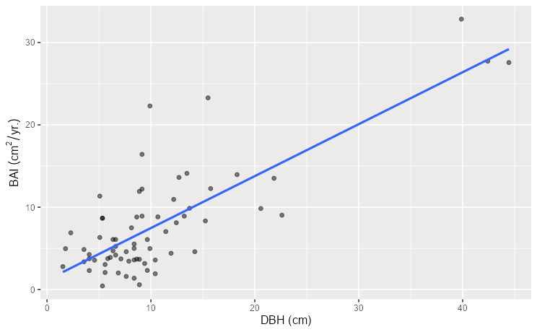
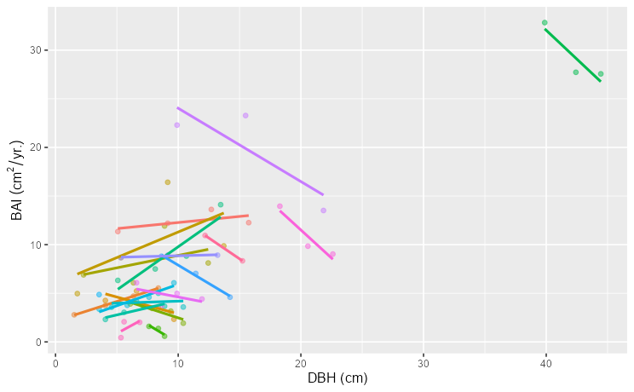
Growth effects
Annual growth- Basal area increment (BAI)
Size, Competition, and Site effects
Generalized Additive Mixed Model (GAMM) approach
$$\ln\left(BAI\right)= f_{1}\left(Size\right)+f_{2}\left(Competition\right)+f_{3}\left(Site\right)+Tree$$
Tree
Notes:
The figures below show BAI vs. DBH for a small sample of data points, fit with an overall linear trend line on the left, and trend lines for each individual tree on the right. The points are exactly the same.
Since these data consist of measurements on the same trees over time each point is not necessarily independent from one another.
So after determining size, competition, and site effects on growth, I accounted for individual variability at the tree-level with an individual tree effect, as shown in the updated equation.

Slide 17
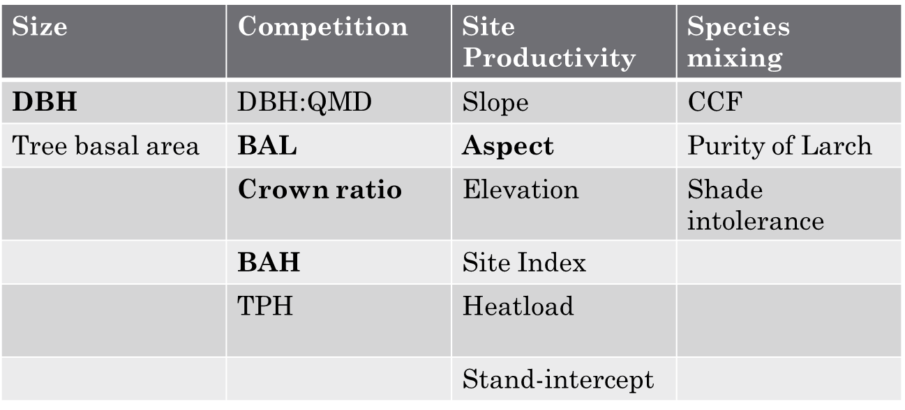
Characterizing growth
Variables were selected from variable groups
Size
Competition
Site
$$\ln\left(BAI\right)=f_{1}\left(DBH\right)+f_{2}\left(BAL\right)+f_{3}\left(CR\right)+f_{4}\left(BAH\right)+f_{5}\left(Aspect\right)$$
RMSE
65%
RMSE
5.64
Notes:
Since each type of effect can be represented by different variables, model predictors were selected from each group.
Correlation between variables in each group was assessed, and any highly correlated variables were not considered in a model together to avoid overlap and collinearity
Instead, closely related variables within each group were compared in separate models to determine which predictor was better at estimating BAI.
Models were compared based on RMSE, which is a measure of model predictive accuracy that is in the same units as BAI.
Its displayed here as a percentage of the mean BAI in the data set for easy interpretation.
The lower the RMSE, the higher the predictive accuracy.
Variables representing tree size were DBH and tree basal area. The model with DBH as a predictor was superior to the alternative, so DBH was used to represent size. The RMSE is shown on the right.

Slide 18
Characterizing growth
Variables were selected from variable groups
Size
Competition
Site
$$\ln\left(BAI\right)=f_{1}\left(DBH\right)+f_{2}\left(BAL\right)+f_{3}\left(CR\right)+f_{4}\left(BAH\right)+f_{5}\left(Aspect\right)$$
RMSE
65%
50%
RMSE
5.64
4.31
Individual tree variables
Plot-level variables
Notes:
Building on size effects, Competition effects were then evaluated
We thought it was important to account for an individual tree’s competitive position respective of other trees in addition to the overall competitive environment that a tree is growing within.
Individual tree competition variables were the ratio of tree diameter to plot quadratic mean diameter, basal area larger than the subject tree, and crown ratio. BAL and Crown ratio were included in the model together.
plot basal area per hectare (BAH), and plot trees per hectare represent the competitive environment, and ultimately BAH was included in the final model.
RMSE is shown on the right, it reflects an improvement with competition variables.

Slide 19
Characterizing growth
Variables were selected from variable groups
Size
Competition
Site
$$\ln\left(BAI\right)=f_{1}\left(DBH\right)+f_{2}\left(BAL\right)+f_{3}\left(CR\right)+f_{4}\left(BAH\right)+f_{5}\left(Aspect\right)$$
RMSE
65%
50%
46%
RMSE
5.64
4.31
4.01
Evaluated together and exclusively
Evaluated exclusive of every other
Notes:
Site productivity variables considered are shown here.
Raw topographic variables like Slope, aspect, and elevation were assessed together and individually before comparing to other variables.
This is because each other variable represents the effects of all three of these.
The outcome of that comparison was then compared to the rest of the group.
The best model accuracy was produced when slope was included in the model with aspect, but this model had a high degree of dependence between aspect, slope, and the competition variables.
This type of dependence is called concurvity, which measures nonlinear dependence among variables in a GAM.
Ultimately aspect was selected as the site-productivity representing variable.
The model RMSE for the model is shown on the right in bold, and again reflects higher predictive accuracy.

Slide 20
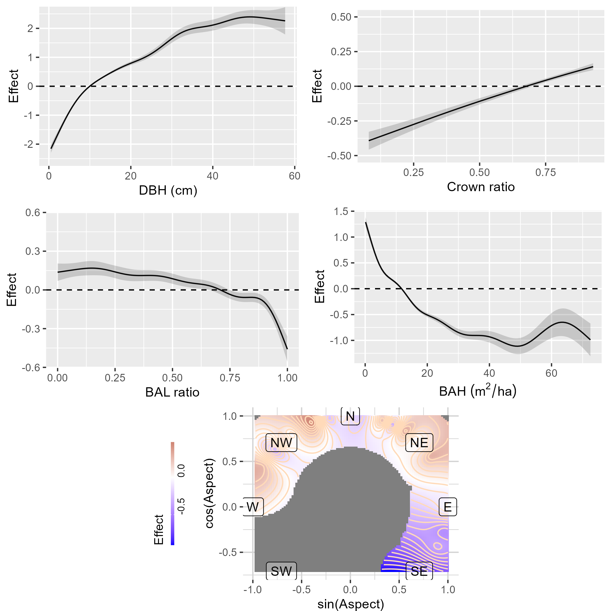
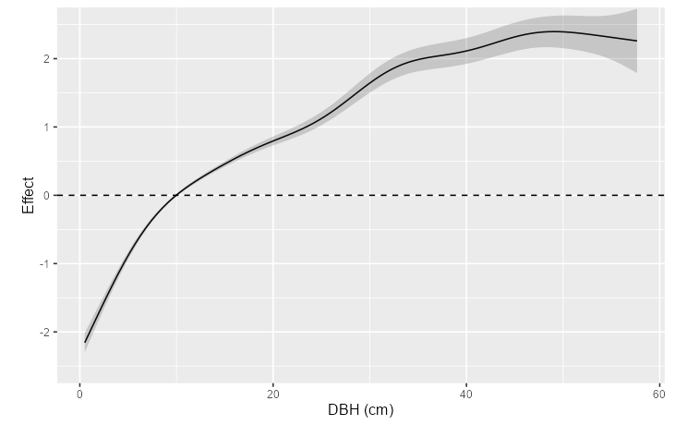
Characterizing growth
$$\ln\left(BAI\right)=f_{1}\left(DBH\right)+f_{2}\left(BAL\right)+f_{3}\left(CR\right)+f_{4}\left(BAH\right)+f_{5}\left(Aspect\right)$$
Effect
DBH (cm)
Notes:
Now that we have a full model, lets take a look at the effects on growth.
The curve shown here shows the marginal effects of DBH on tree growth. The y-axis is the effect on growth on the log-link scale, and the x-axis is DBH.
The log-link effect on the y-axis can simply be interpretted as a unitless multiplicative effect on BAI, but keep in mind that BAI can only be positive.
With that said, after accounting for other variables, the effect of DBH on growth increases with DBH, showing a higher rate of increase at lower values, and then tapers at high values.
This curve is very similar to the relationships identified in previous works.

Slide 21
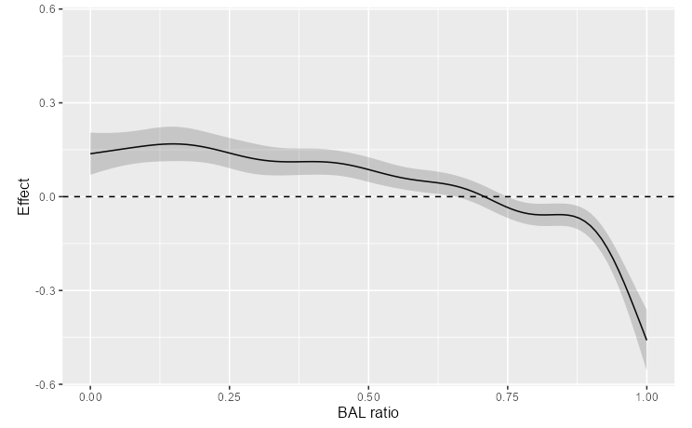
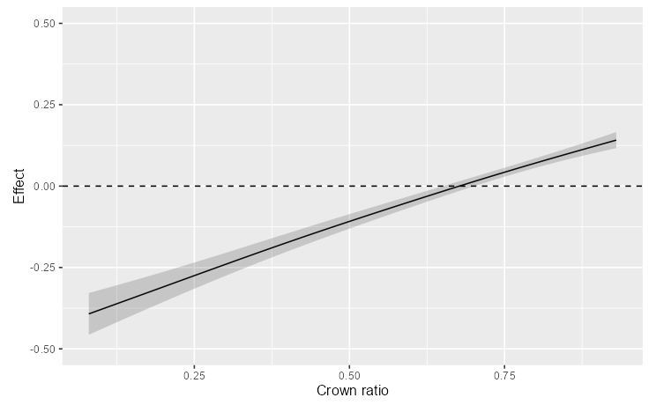
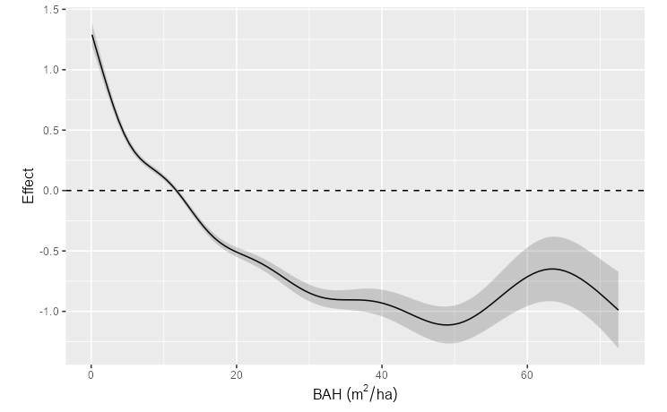
Characterizing growth
$$\ln\left(BAI\right)=f_{1}\left(DBH\right)+f_{2}\left(BAL\right)+f_{3}\left(CR\right)+f_{4}\left(BAH\right)+f_{5}\left(Aspect\right)$$
Effect
Effect
BAL
Crown ratio
Effect
BAH
Notes:
Here we see the partial effects for BAL on the top left, Crown ratio on the top right, and BAH at the bottom.
BAL is a ratio of plot basal area in trees larger than the subject tree (whose growth is being estimated).
So small values represent larger trees that don’t have larger competitors, and larger values represent smaller trees which are being out-competed by larger trees.
Looking at the top left curve,
BAL doesn’t appear to have much of an effect on growth until values are in excess of 0.8,
This means that western larch trees with larger neighbors are negatively impacted.
Looking to the right, Crown ratio was fit as a near-linear term where higher values were associated with more growth.
At the bottom, BAH had an overall negative effect on growth as it increased which eventually tapered to a constant effect higher densities.
These relationships are more or less similar to previously established relationships.

Slide 22
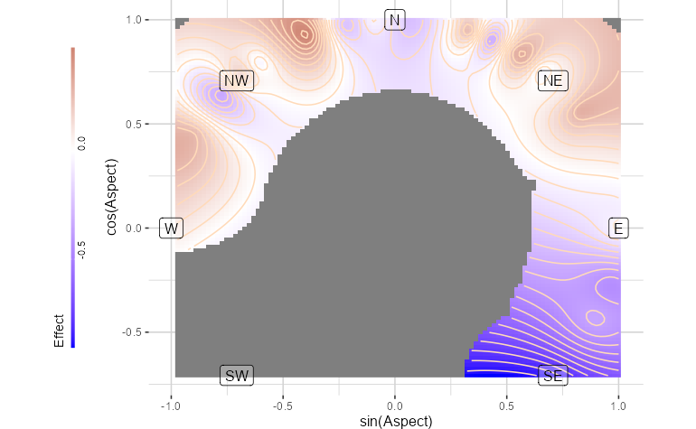
Characterizing growth
$$\ln\left(BAI\right)=f_{1}\left(DBH\right)+f_{2}\left(BAL\right)+f_{3}\left(CR\right)+f_{4}\left(BAH\right)+f_{5}\left(Aspect\right)$$
Effect
cos(aspect)
sin(aspect)
Notes:
Finally, here is how BAI varied with aspect.
Since aspect is a circular measure between 0 and 360 degrees, it couldn’t be related to growth in any straightforward way without applying a data transformation.
So, in the final model aspect was represented as the interaction of the sine and cosine transformations of aspect representing east-west and north-south, respectively.
Here I am showing aspect in the same orientation as a compass.
The effect on BAI is shown by contours similar to a topographic map.
The color indicates positive or negative effects with red and blue, respectively.
Looking at this figure, we can see that BAI varied with aspect, noting varying positive and negative effects on northern aspects.
And then more negative effects towards southern aspects.
Of note, however, is that there simply was not data observed on S-SW aspects, so that’s why that area is grey.
The variability in aspect effects are likely reflective of the fact that aspect is capturing effects beyond its scope.

Slide 23
Characterizing growth
Described effects of size, competition, site with similar relationships to other models
BAL applied as a ratio, not quantity
Many models use aspect, slope, elevation – this one did not
Notes:
In summary,
based on the improvements seen in RMSE, in addition to the similarities of functional relationships to previous works, I’d say this objective was successfully accomplished.
However, a few things of note are
BAL was a little bit different than previous works because I used a ratio instead of the quantity of basal area in larger trees.
I did this because it otherwise shared a high correlation with plot basal area, and other variables weren’t as good as capturing the individual tree competition effect.
Using aspect as the only site effect might have some issues
The primary concern being that this assumes that the effects of elevation and slope on growth are constant for an aspect, which isn’t necessarily true.
Perhaps a different model selection approach would yield in a different result
In all, my methodology led me to this model – its not perfect, but it captures the effects I was looking for in the data, so let’s move forward.

Slide 24
Objectives
Describe how W. Larch growth varies with tree size, competition, density, and site productivity.
Identify if these effects on growth differ between mixtures and pure larch conditions
Compare different measures of species-mixing as predictors of growth
Notes:
So, I showed how western larch growth varies with size, competion, density and site productivity.
Now let’s look at how these effects vary if western larch is growing in different mixtures.

Slide 25
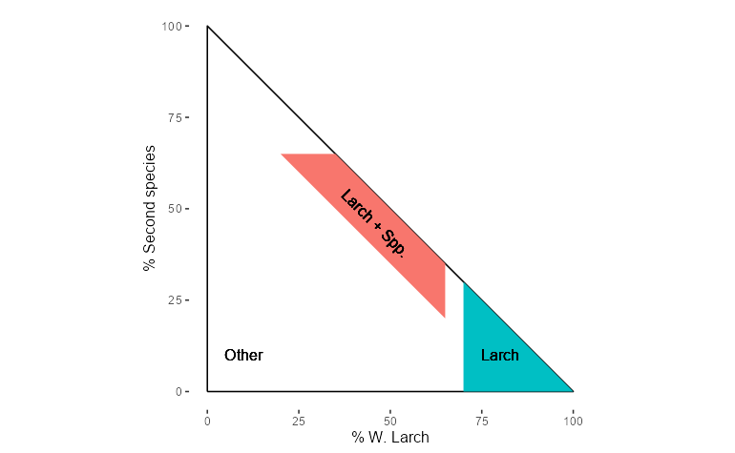
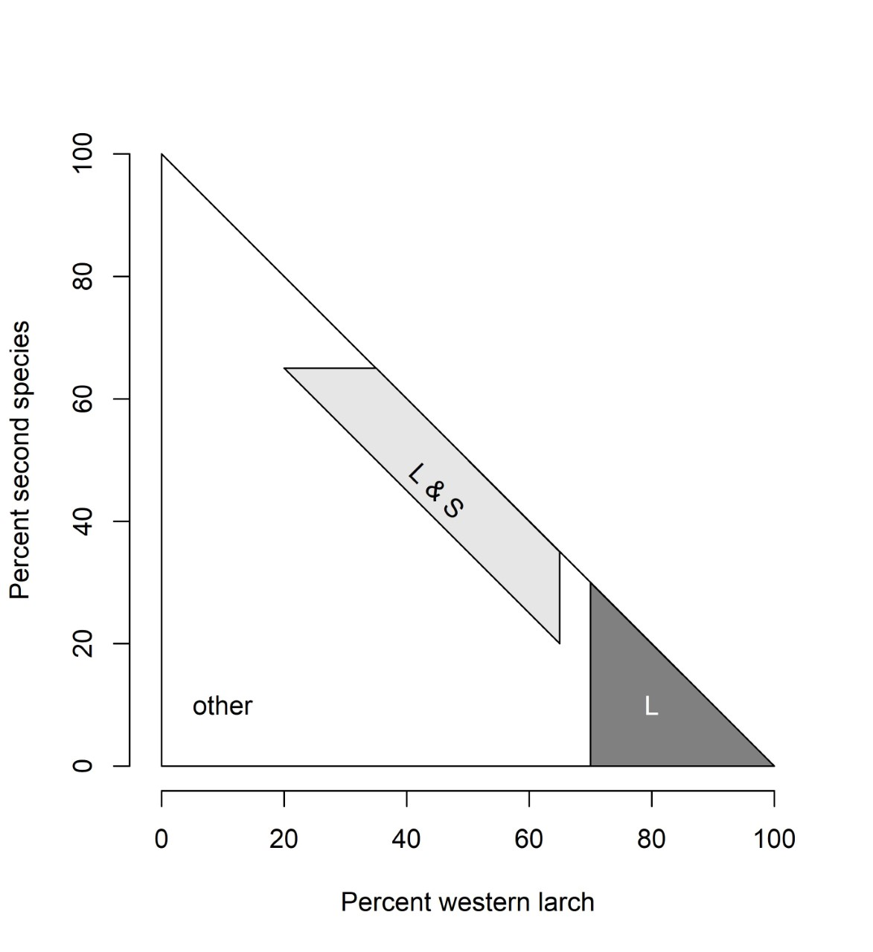
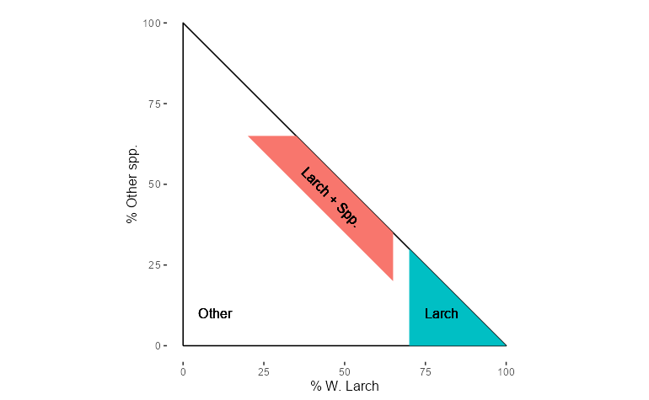
Effects on W. larch growth in mixtures vs. pure larch conditions
Identified specific mixtures
Larch-lodgepole pine
Larch-Douglas-fir
Pure larch
Notes:
First, I needed to figure out how to define a mixture.
I did this by calculating the proportion of basal area for every species in a plot.
To qualify as a mixture, the total basal area in a plot had to be at least 20% larch, and at least 20% of another species.
On its own, neither species could occupy more than 65% of plot basal area.
And together both species had to occupy a minimum of 70% plot BA.
These parameters create the red polygon on the plot
To qualify as a pure larch plot, larch itself had to occupy at least 70% of plot basal area.
This is shown by the blue wedge.
Although other mixtures exist, they were not included in the analysis
These seemingly arbitrary percentages guaranteed that western larch was mixed with one other species, and not any other species,
It also made sure that no species was over-represented in a mixture.
Although I identified various mixtures of larch with other species, there was only an ample amount of data for larch mixed with lodgepole pine and larch mixed with douglas fir, of course in addition to pure larch conditions.

Slide 26
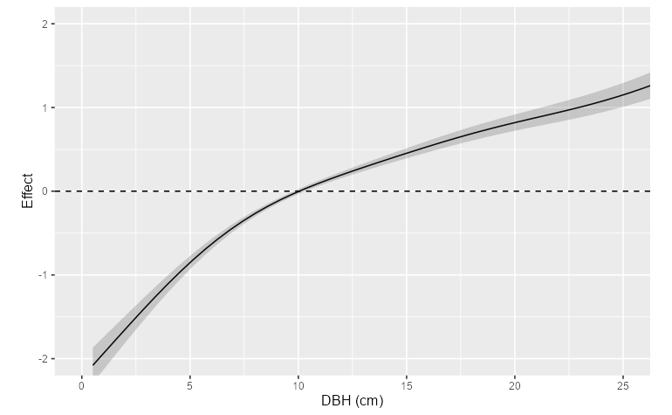
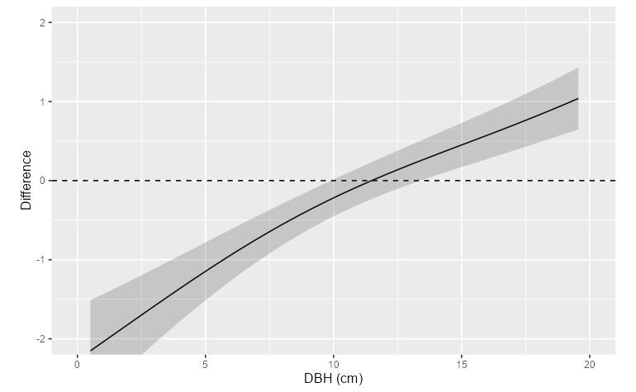
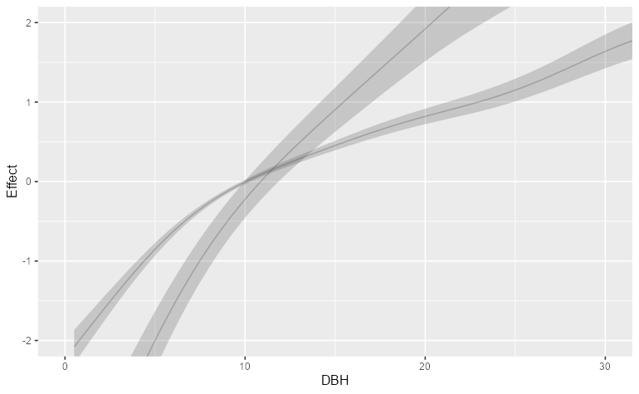
Effects on W. larch growth in mixtures vs. pure larch conditions
Fit model, allowing an offset for each mixture
Contrast mixtures from pure-larch conditions
Pure larch reference
Difference of mixture from reference
+
Reference + Difference
=
Reference
Notes:
To assess growth effects across conditions, I fit the same model as before on the subset of data including the pure larch and mixture data, where each condition was identified with an identifying variable.
This resulted in a model that allowed pure larch conditions to represent a reference level that each mixture condition was compared to.
The figures help illustrate this analysis.
A pure larch reference smooth was fit by the model, like the one shown at the top left.
Simultaneously, a smooth for each mixture was fit showing how an effect on growth differs from the relationship of the pure conditions.
The figure at the top right shows red and green arrows, indicating differences in a mixture from the pure larch smooth.
When added to the reference smooth, this difference smooth can represent the effects of a given mixture.
Now looking at the figure at the bottom, the reference smooth gets offset to display the smooth for a given mixture. The arrows correspond to those above.
Additionally, an F-test was conducted to evaluate whether a mixture’s smooth was different from the reference smooth.
P-values will be shown for this test, where low-pvalues indicate evidence for a difference.
In other words, a GAM was fit with a reference relationship for each predictor for pure larch conditions and then relationship characterizing offsets from the reference were fit for each of the mixtures.
The the reference relationship is called a reference smooth, and the mixture offsets are referred to as difference smooths.
The difference smooths are used to identify how a given functional relationship in a mixture differs from the corresponding fitted reference smooth.

Slide 27
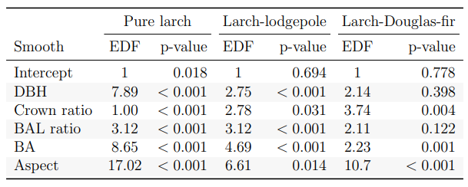
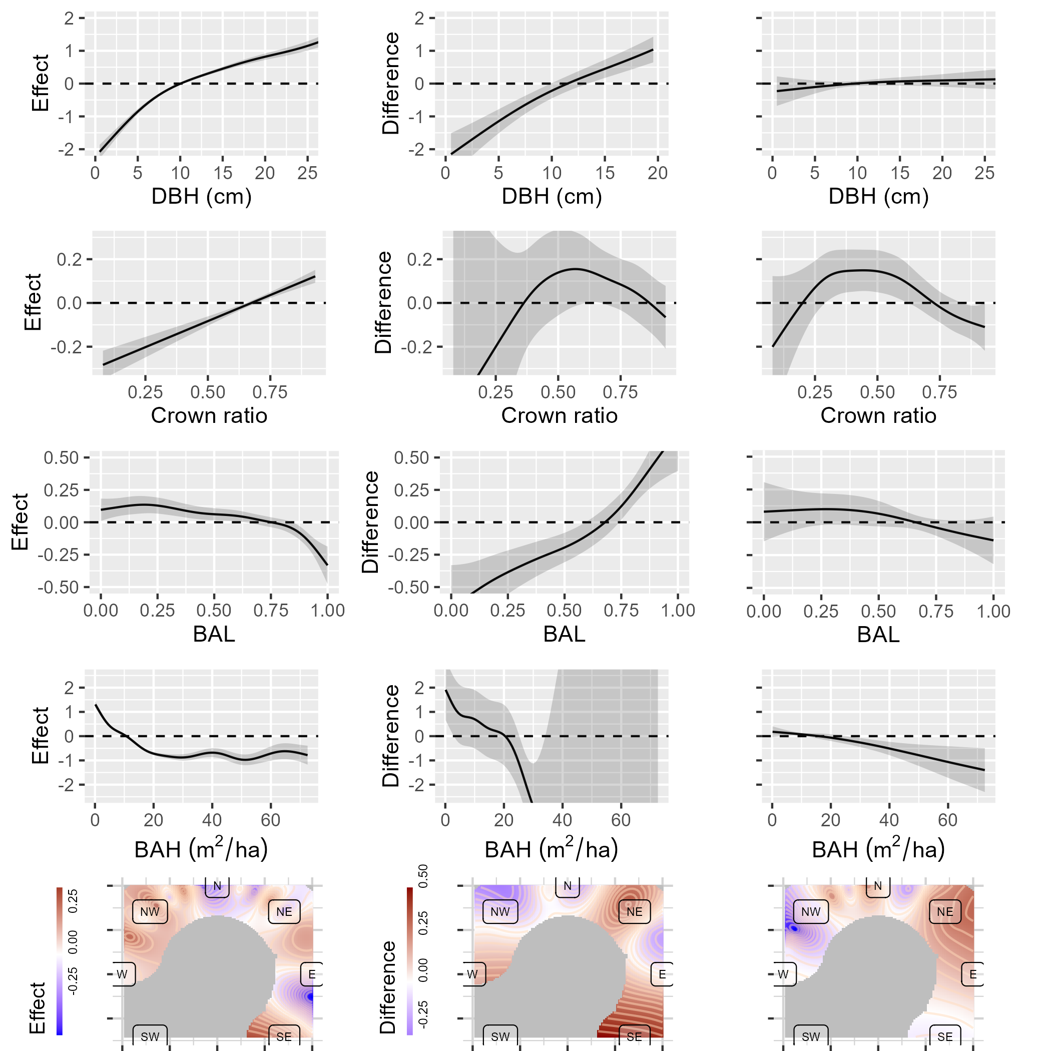
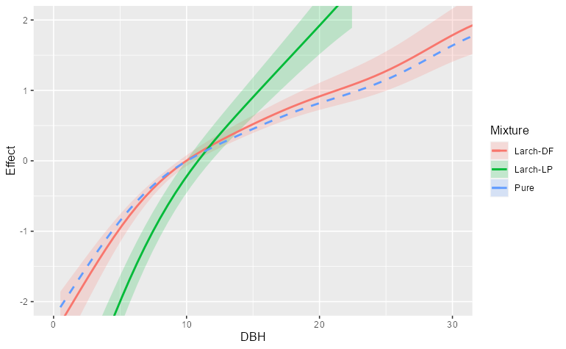
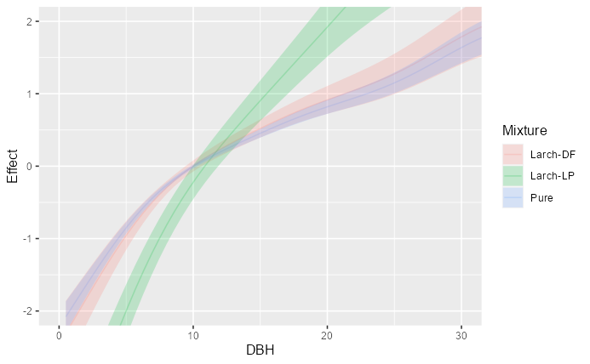
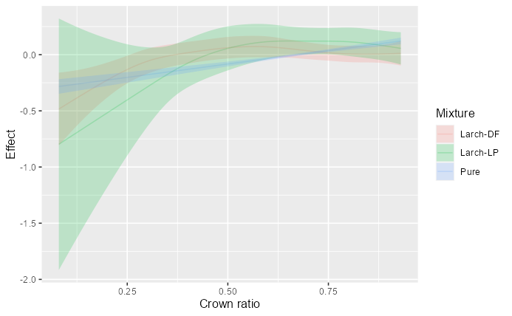
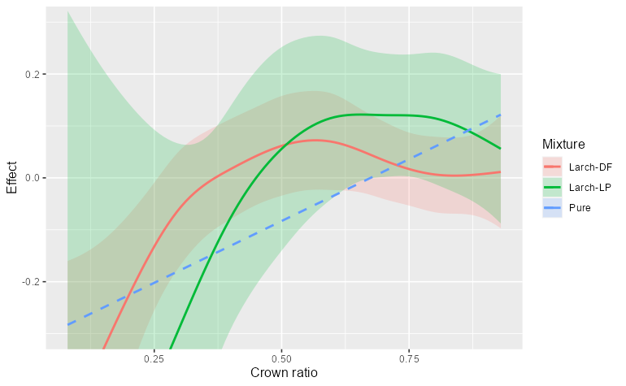
Effects on W. larch growth in mixtures vs. pure larch conditions
Larch-lodgepole pine
Larch-Douglas-fir
p<0.001
p<0.001
P=0.398
Pure larch
p<0.001
p=0.031
p=0.004
Notes:
Estimated smooths with offsets from mixtures applied are shown for DBH and Crown ratio effects.
In the table on top, we can see the p-values associated with the test that a mixture smooth was different from the reference conditions.
Reference smooths also had p-values, which simply indicate evidence that the smooth was a non-flat function.
EDF stands for effective degrees of freedom, and higher values simply indicate more complexity in a smooth.
In the figures Blue represents the reference smooth, green represents larch-Lodgepole pine mixtures, and red represents larch-douglas fir mixtures.
As reminder, these smooths are for western larch growth within each of these conditions, not the other species.
Each mixture smooth shown with 2 standard errors shaded in the corresponding colors.
If a mixture smooth’s shaded region crosses the reference smooth, then there is not a difference at that point.
So these results show that DBH effects on western larch BAI are different when larch is mixed with lodgepole pine.
That is, when mixed with lodgepole pine, smaller trees would see lower growth rates, and larger trees would see higher growth rates, as shown by a visual comparison of the green and blue curves in the figure on the left.
There was no evidence that the smooth for douglas fir-mixed larch was different, shown by a higher p-value and a difference smooth that doesn’t deviate from the reference, shown by comparing the red and blue curves on the left.
In the crown ratio effects on growth, there was only a difference in the larch when mixed with douglas fir, but the smooths show a somewhat unremarkable difference overall in the figure on the right, comparing red and blue.
The colored figure on the right shows that both mixtures hold very similar effects on growth to the reference conditions.
are shown here on the left with shaded regions representing 2 standard errors. If the shaded region crosses the 0 line, then there likely is not a difference at that point.
The right two columns show difference smooths for the larch-lodgepole pine mixtures, and mixtures of larch and douglas fir.
The difference smooths show how a smooth relationship in a mixture differs from the effect shown in the reference condition across the range of the predictor on the x-axis.
Their associated p-values indicate evidence that the smooth relationship for a mixture is different from reference smooth if the p-values are very low, which are indicated with bold text.
On the right, I’ve applied the offsets in each difference smooth to create curves for each condition. Where blue represents the pure larch reference conditions, green represents larch mixed with lodgepole pine, and red represents larch mixed with douglas-fir

Slide 28
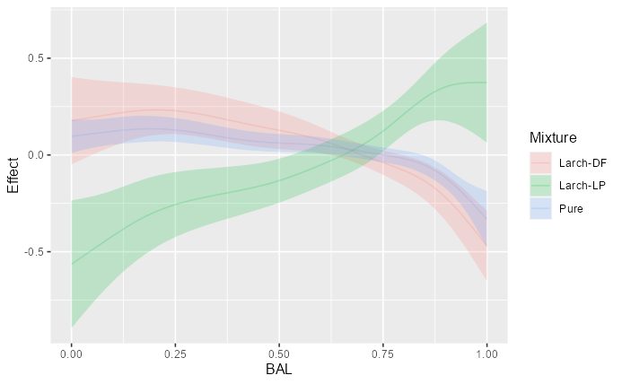
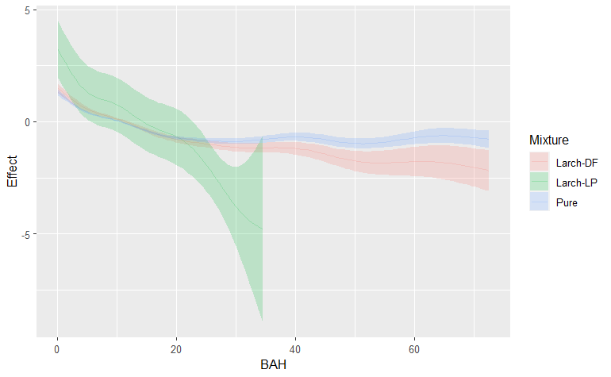
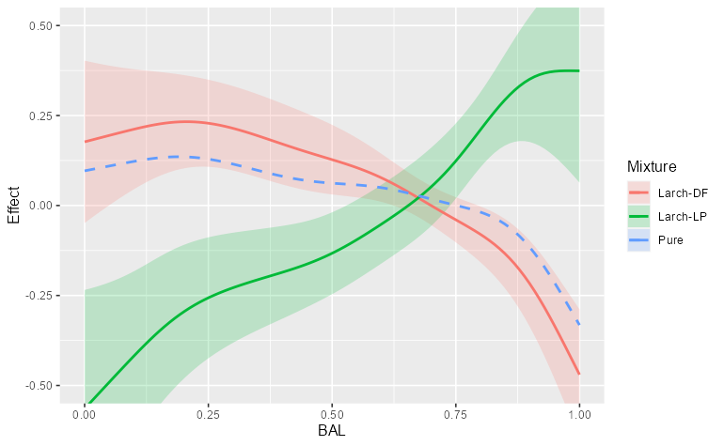
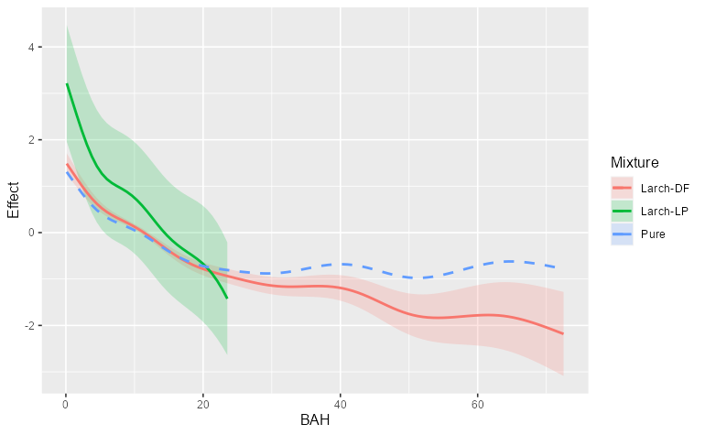
Effects on W. larch growth in mixtures vs. pure larch conditions
Larch-lodgepole pine
Larch-Douglas-fir
p<0.001
p<0.001
P=0.398
Pure larch
p<0.001
p=0.031
p=0.004
Notes:
BAL is shown on the left where where there is an interesting difference in the growth effect when larch is mixed with lodgepole pine, shown by the green curve.
Comparing green to blue, there appears to be a negative difference at lower values of BAL, and a positive difference at higher values of BAL.
This means that holding everything else constant, and when in lodgepole pine mixtures, larch that are competitively dominant grow less compared to when growing with other western larch, and trees that are less competitively dominant grow more
This result is surprising considering that lodgepole pine is also very intolerant of shade just like western larch.
If anything, I expected that there would be less growth at higher values of BAL. in lodgepole pine mixtures.
As it turns out, this may be explained by differences in the data structure of the lodgepole pine mixture compared to the pure larch conditions. I’ll revisit that point in just a moment.
The BAH curves are shown on the right, where there was strong evidence that the effect on larch growth was different in each mixture.
The first thing to point out here is that the lodgepole pine mixtures simply lacked data at large BAH values, which is why the green smooth is not plotted at higher values.
In Douglas-fir mixtures there is a smaller effect on BAI at high values of BAH, meaning that at higher densities in mixtures with Douglas-fir, western larch growth is lower.

Slide 29
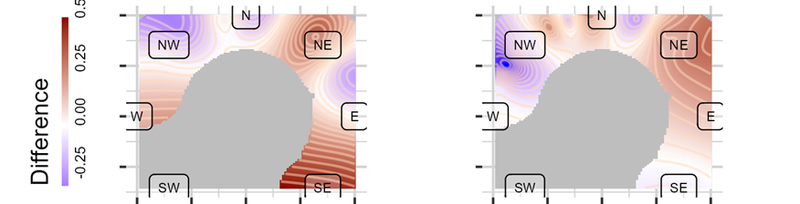
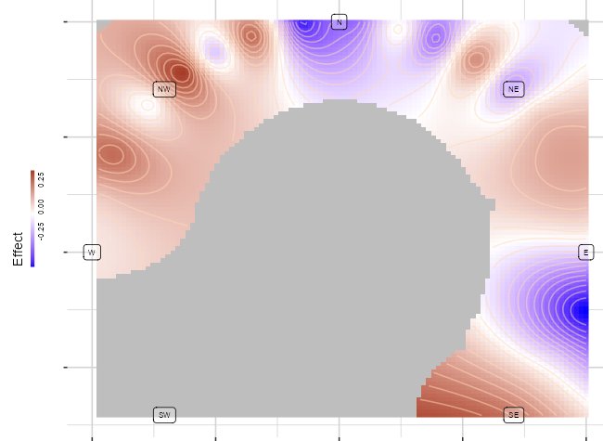
Growth effects compared between mixtures and pure conditions
Larch-lodgepole pine
Larch-Douglas-fir
p<0.001
p<0.001
P=0.398
Pure larch
p<0.001
Larch-lodgepole pine
Larch-Douglas-fir
p=0.031
p=0.004
Notes:
The aspect partial differences are shown at the bottom where there was evidence for a different effect in each mixture, indicated by lower p-values.
Since this is a multi-dimensional figure, we have to settle for the differences, instead of offsets.
The figure on the left shows that Larch growing with lodgepole saw positive differences on northeast aspects
And in the middle, larch growing with douglas fir saw negative differences when growing on northwest aspects.

Slide 30
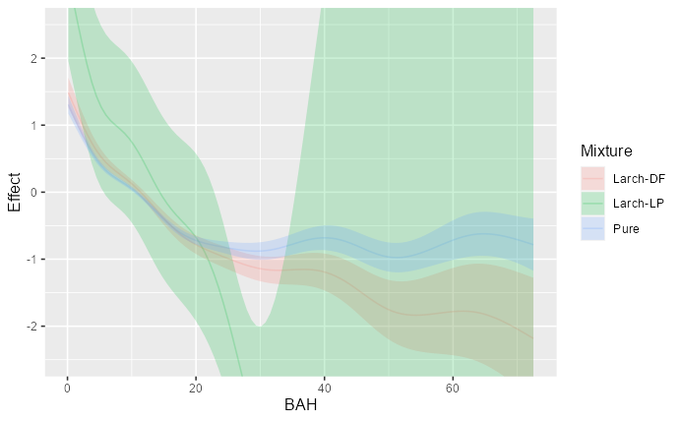
Growth effects compared between mixtures and pure conditions
Pure larch
Larch-lodgepole pine
Larch-Douglas-fir
p<0.001
p<0.001
p=0.122
p<0.001
p<0.001
p=0.001
p<0.001
p=0.014
p<0.001
Notes:
BAL is shown on the top row here where there is an interesting difference shown in the growth effect when larch is mixed with lodgepole pine in the difference smooth on the top left.
It shows a negative difference at lower values, and a positive difference at higher values.
This means that holding everything else constant, and when in lodgepole pine mixtures, larch that are competitively dominant actually grow less compared to when growing with other western larch, and trees that are less competitively dominant grow more, holding everything else constant.
This result is surprising, and difficult to find an explanation for considering that lodgepole pine is also very intolerant of shade. If anything, I expected that there would be less growth at higher values of BAL. in lodgepole pine mixtures.
As it turns out, this may be explained by differences in the data structure of the lodgepole pine mixture compared to the pure larch conditions. I’ll revisit this topic in a moment.
BAH is shown in the middle row on the left, where there was strong evidence that the effect on larch growth was different in each mixture.
The differences shown translate to the estimated curves on the right.
The first thing to point out here is that the lodgepole pine mixture has very high uncertainty at BAH values greater than 30, shown by the extremely wide shaded region.
This is simply a result of a lack of high basal area data in lodgepole pine mixtures. Those values are excluded from plotting on the right.
In both mixtures, we see that at higher values of BAH, there is a smaller effect on BAI.
The aspect partial differences are shown at the bottom left where there was evidence for a different effect in each mixture
Larch growing with lodgepole saw positive differences on northeast aspects
Larch growing with douglas fir saw negative differences when growing on northwest aspects.

Slide 31
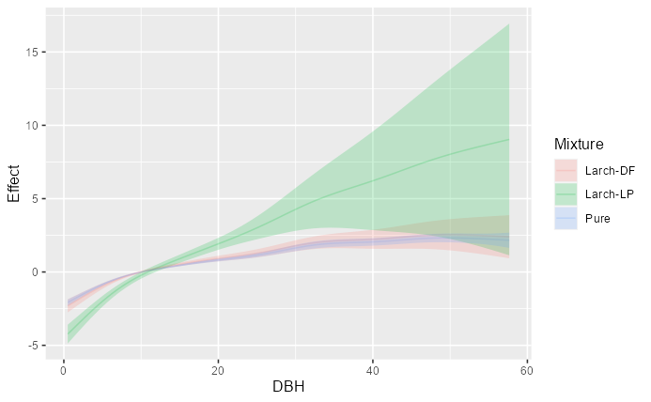
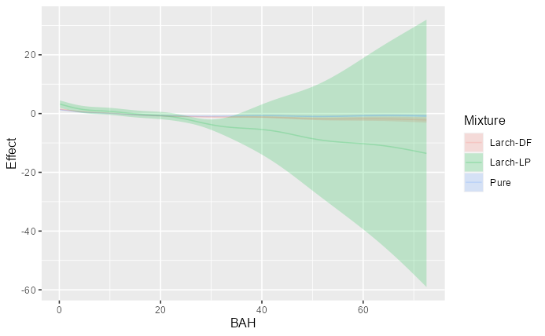

Slide 32
Growth effects compared between mixtures and pure conditions

Slide 33
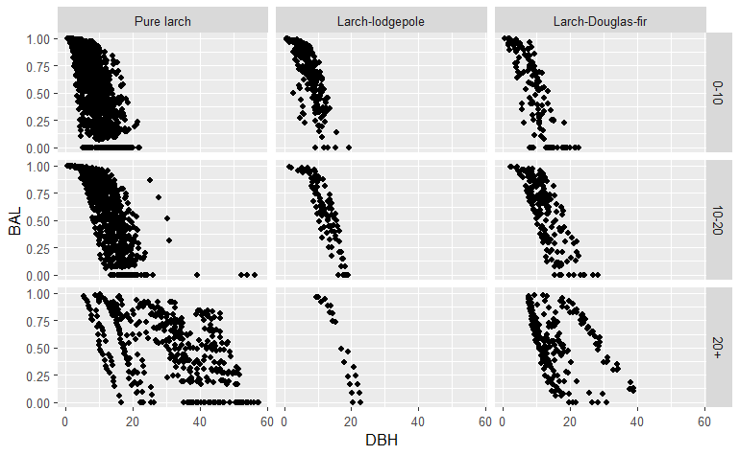
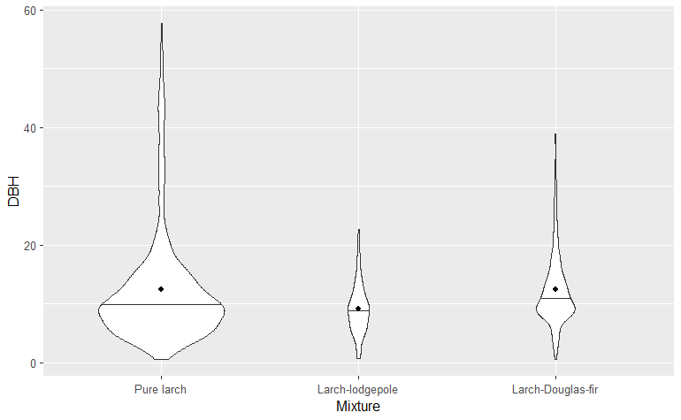
Effects on W. larch growth in mixtures vs. pure larch conditions
Size, competition, site effects on W. Larch growth differed in mixtures compared to pure conditions
Limited BAH data for lodgepole pine
Evaluate larch with species that are more shade-tolerant than Douglas-fir
Many more mixtures to look at
Growth of other species should also be assessed
Notes:
The difference smooth results suggest that the effects of size, competition, and site on growth are indeed different when larch is mixed with lodgepole pine or douglas fir, but the results varied by mixture and predictors.

Slide 34
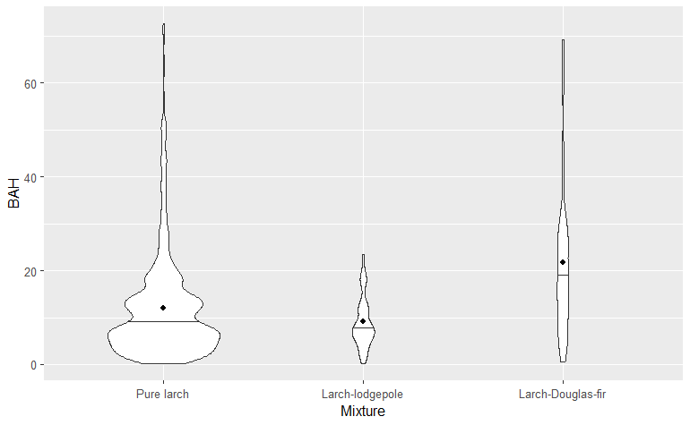

Effects on W. larch growth in mixtures vs. pure larch conditions
Size, competition, site effects on W. Larch growth differed in mixtures compared to pure conditions
Limited BAH data for lodgepole pine
Evaluate larch with species that are more shade-tolerant than Douglas-fir
Many more mixtures to look at
Growth of other species should also be assessed
Notes:
However, these results were not without limitations.
The plot to the top right shows distributions of BAH for each mixture, the pure larch on the left, larch-lodgepole on the right, and larch-douglas fir on the right.
The range and density of data in the lodgepole pine mixtures is much smaller than the pure larch conditions, as noted earlier.
This could explain why the growth effects of BAL were characterized so differently from the reference.
Since BAL is the ratio of plot basal area (or BAH) in trees larger than a subject, and since these effects are being compared between conditions that have different ranges of values, BAL can have a different meaning between lodgepole pine and pure larch conditions.
In other words, BAL when applied as a ratio probably should not be directly compared between conditions when there is this type of imbalance in data.

Slide 35
Effects on W. larch growth in mixtures vs. pure larch conditions
Shade intolerant
W. Larch
Lodgepole pine
Size, competition, site effects on W. Larch growth differed in mixtures compared to pure conditions
Limited BAH data for lodgepole pine
Evaluate larch with species that are more shade-tolerant than Douglas-fir
Many more mixtures to look at
Growth of other species should also be assessed
Ponderosa pine
White pine
Douglas-fir
Grand fir
Subalpine fir
Engelmann spruce
Not enough data
W. Redcedar
W. Hemlock
Pacific yew
Shade tolerant
Notes:
Also, there was not enough data for larch growing with shade tolerant spruce or fir to analyze.
This makes it difficult to comment on whether shade tolerance can explain differences in growth effects, especially since douglas fir is only moderately shade tolerant and the differences in douglas fir mixtures were somewhat unremarkable.

Slide 36
Effects on W. larch growth in mixtures vs. pure larch conditions
Size, competition, site effects on W. Larch growth differed in mixtures compared to pure conditions
Limited BAH data for lodgepole pine
Evaluate larch with species that are more shade-tolerant than Douglas-fir
Many more mixtures to look at
Growth of other species should also be assessed
Notes:
Another limitation was the way that mixtures were characterized here.
When larch is found in mixtures, it typically is characterized by more than just one other species.
One way to add more depth to this type of analysis would be to assess the growth of the other species that larch is growing with.
That analysis unfortunately did not fit into this project.
In summary,
Some of these predictors had a different effect on growth in mixtures.
For this information to be more useful in growth modeling,
It would be better to capture this effect in a more general way since there are bunch of different types of mixtures that western larch grows within.

Slide 37
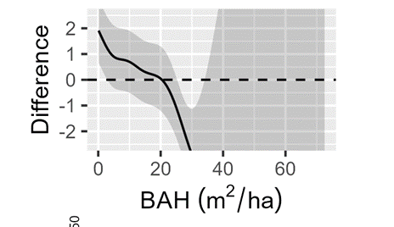
Comparing mixtures to pure larch conditions
LP differences larger than DF
Data limitations
Need more shade-tolerant species
Design limitations
Different ranges of BAH
Should assess growth of other species
p<0.001
p<0.001
Notes:
The difference smooths results suggest that the effects of size, competition, and site on growth are indeed different when larch is mixed with lodgepole pine or douglas fir, depending on the effect.
The results showed larger differences in lodgepole pine mixtures than in douglas fir mixtures.
However, these results were not without limitations
First and foremost, there simply was not enough data for larch growing with shade tolerant spruce or fir to analyze.
This makes it difficult to comment on whether shade tolerance can explain differences in growth effects, especially since the differences in douglas fir mixtures were unremarkable.
Another limitation is illustrated in the figure on the top right.
This plot shows distributions of BAH for each mixture.
The range and density of data in the lodgepole pine mixtures is much smaller than the pure larch conditions.
This is why lodgepole pine mixture BAH difference smooth had such a wide shaded region in its curve
BAL may have been affected by this discrepancy as well.
Since BAL is the ratio of plot basal area (or BAH) in trees larger than a subject, and since these effects are being compared between conditions that have different ranges of values, BAL can have a different meaning between lodgepole pine and pure larch conditions.
In other words, BAL when applied as a ratio probably should not be directly compared between conditions when there is this type of imbalance in data.
Lastly, one way to add more depth to this type of analysis would be to assess the growth of the other species that larch is growing with. That analysis unfortunately did not fit into this project.

Slide 38
Objectives
Describe how W. Larch growth varies with tree size, competition, density, and site productivity.
Identify if these effects on growth differ between mixtures and pure larch conditions
Compare different measures of species-mixing as predictors of growth
Notes:
So that leads us to the third objective, where I’ll show you how I explored how to capture species-mixing effects on growth in addition to the other effects.

Slide 39
Objectives
Identify a growth model (without species-mixing)
Identify differences in larch growth between mixtures and pure larch conditions
Compare different measures of species-mixing in the model
Notes:
With that growth model, we can now look at how larch growth varies across mixtures.

Slide 40


Species-mixing effects
Crown competition factor (CCF)
$$f_{4}\left(BAH\right)$$
$$\ln\left(BAI\right)=f_{1}\left(DBH\right)+f_{2}\left(BAL\right)+f_{3}\left(CR\right)+f_{4}\left(CCF\right)+f_{5}\left(Aspect\right)$$
Notes:
I identified three species-mixing measures that describe composition at the plot level:
Each one was added as an additional predictor to the established model.
The first one is a commonly used metric called crown competition factor (or CCF)
CCF quantifies the area that tree crowns occupy based on species-specific crown allometries.
It’s essentially a species-informed weighted measure of crowding.
One caveat is that CCF and BAH were highly correlated. This makes sense because CCF is commonly used as a density and competition measure.
Thus, CCF was used in place of BAH in the model.
The next measure is a simple proportion of plot basal area in western larch, which I’m calling purity of larch.
Lastly I quantified the relative shade-tolerance of a plot.
I used the shade tolerance index developed by Lienard et al 2015
This index quantifies the shade tolerance of species based on forest succession in 5 categories from very shade tolerant to very intolerant
Species and their shade tolerance values are shown on the right, scaled where 1 is shade intolerant, and 0 is shade tolerant.
I used these values to identify the relative shade tolerance of a plot by basal area.
I added each of these metrics as an additional predictor in the model to evaluate their effects on growth after accounting for size, competition, and site effects, as shown by the equations below.
One caveat is that CCF and BAH were highly correlated. This makes sense because CCF is commonly used as a density and competition measure.
Thus, CCF was used in place of BAH in the model.
To compare each species-mixing term, I calculated the overall predictive accuracy of each model using a withheld portion of the data set.

Slide 41

Species-mixing effects
Crown competition factor (CCF)
Purity of larch: % of plot BA in larch
$$f_{4}\left(BAH\right)$$
$$\ln\left(BAI\right)=f_{1}\left(DBH\right)+f_{2}\left(BAL\right)+f_{3}\left(CR\right)+f_{4}\left(CCF\right)+f_{5}\left(Aspect\right)$$
$$\ln\left(BAI\right)=f_{1}\left(DBH\right)+f_{2}\left(BAL\right)+f_{3}\left(CR\right)+f_{4}\left(BAH\right)+f_{5}\left(Aspect\right)+f_{6}(Purity)$$
Notes:
The next measure is a simple proportion of plot basal area in western larch, which I’m calling purity of larch.
This was added in addition to the other predictors in the model
Lastly I quantified the relative shade-tolerance of a plot.
I used the shade tolerance index developed by Lienard et al 2015
This index quantifies the shade tolerance of species based on forest succession in 5 categories from very shade tolerant to very intolerant
Species and their shade tolerance values are shown on the right, scaled where 1 is shade intolerant, and 0 is shade tolerant.
I used these values to identify the relative shade tolerance of a plot by basal area.
I added each of these metrics as an additional predictor in the model to evaluate their effects on growth after accounting for size, competition, and site effects, as shown by the equations below.
One caveat is that CCF and BAH were highly correlated. This makes sense because CCF is commonly used as a density and competition measure.
Thus, CCF was used in place of BAH in the model.
To compare each species-mixing term, I calculated the overall predictive accuracy of each model using a withheld portion of the data set.

Slide 42
Species-mixing effects
Shade intolerant
1
W. Larch
Lodgepole pine
Crown competition factor (CCF)
Purity of larch: % of plot BA in larch
Shade intolerance: a weighted proportion of BA
Values from Lienard et al. (2015)
Values inverted for scaling
0.75
Ponderosa pine
White pine
0.5
Douglas-fir
Grand fir
$$f_{4}\left(BAH\right)$$
0.25
Subalpine fir
$$\ln\left(BAI\right)=f_{1}\left(DBH\right)+f_{2}\left(BAL\right)+f_{3}\left(CR\right)+f_{4}\left(CCF\right)+f_{5}\left(Aspect\right)$$
Engelmann spruce
W. Redcedar
$$\ln\left(BAI\right)=f_{1}\left(DBH\right)+f_{2}\left(BAL\right)+f_{3}\left(CR\right)+f_{4}\left(BAH\right)+f_{5}\left(Aspect\right)+f_{6}(Purity)$$
0
W. Hemlock
Pacific yew
$$\ln\left(BAI\right)=f_{1}\left(DBH\right)+f_{2}\left(BAL\right)+f_{3}\left(CR\right)+f_{4}\left(BAH\right)+f_{5}\left(Aspect\right)+f_{6}(Shade Intol.)$$
Shade tolerant
Notes:
Lastly I quantified the relative shade-tolerance of a plot.
I used the shade tolerance index developed by Lienard et al 2015
This index quantifies the shade tolerance of species based on forest succession in 5 categories between 0 and 1, from very shade tolerant to very intolerant, respectively.
Species and their shade tolerance values are shown on the right,
I inverted the original scale, so 1 is shade intolerant, and 0 is shade tolerant.
I used these values to identify the relative shade tolerance of a plot by basal area.
Once I had three respective models for each species-composition informed metric I compared them to each other by assessing the accuracy of each model using a withheld portion of data, and also assessed their partial effects on growth.

Slide 43



Species-mixing effects
Effect
CCF
Purity
Shade intolerance
Model | RMSE | Deviance explained
No species-mixing | 55.8% | 84.91%
CCF | 55.6% | 84.42%
Purity | 53.2% | 85.07%
Shade intolerance | 53.6% | 85.02%
Notes:
Here are the results of this analysis.
I’m only showing the partial effects of each of the species-mixing-terms because the others remain un-changed.
CCF, in the left figure, has a similar effect on growth to what we saw in BAH earlier
this is unsurprising considering that CCF is used to characterized density and competition.
Since it accounts for these things, it shows a larger effect on growth than purity as well as shade intolerance (note the scales).
Both purity and shade intolerance display a decreasing effect on growth as their values increase.
The relationships fitted for each show somewhat complex, non-monotonic relationships, as seen by the wiggliness of each curve.
However, both the purity and shade intolerance curves suggest that western larch growth would be higher when growing with other species as well as with species that are more shade-tolerant than it, after accounting for the effects of size, competition, and site productivity.
The table below the curves shows each term’s associated model accuracy and percent of null deviance explained.
Deviance explained is analogous to R-squared, so it can be interpreted as an assessment of model fit where higher values indicate better fit.
The top row is for the model without any species mixing information for comparison.
The lowest RMSE was for purity, followed by shade intolerance, and then CCF.
The drops in RMSE from the no-species-mix model to each other model was somewhat modest, but still relevant since each model already is accounting for other effects.
Both the purity and shade intolerance models had higher explained deviance than the model without species-mixing information
But CCF was associated with lower explained deviance from the no-species mixing model.
But changes in deviance explained values were overall somewhat unremarkable

Slide 44


Species-mixing effects
Effect
Purity and shade intolerance can be useful in growth models
W. larch growth higher in mixtures and with shade-tolerant
Need data for larch in more shade-tolerant mixtures
Other variables could capture a mixing effect
Purity
Effect
Shade intolerance
Notes:
In all, the improvements to model accuracy associated with both purity and shade intolerance indicate that this type species-mixing information can account for effects not captured by size, competition, and density.
On top of that, these results generally suggest that western larch growth can be higher when growing in mixtures with other species, holding everything else constant.
Although I did not quantify niche complementarity, these results are consistent with the hypothesis that niche complementarity can positively impact growth
Since these plots show complex relationships, they can be hard to interpret.
To create a more interpretable relationships, these could be modeled with parametric functions instead of data-driven smooths like these ones.
But, doing that may lead to biased estimates and perhaps sacrifice model performance
So ultimately there are tradeoffs to be considered when modeling these types of relationships.
Another note is that shade intolerance had few data at low values, and no data below 0.25,
so before exploring a parametric function for shade intolerance, it would interesting to see the growth effects in that area.
Lastly, the variables that I used here are more or less focused on competition for light, but competition between species may also occur below ground or in other ways not captured here, so other types of variables should be explored in future research.

Slide 45
Objectives
Describe how W. Larch growth varies with tree size, competition, density, and site productivity.
Identify if these effects on growth differ between mixtures and pure larch conditions
Compare different measures of species-mixing as predictors of growth
Notes:
Okay so we’ve gotten through these objectives, now let’s take a step back

Slide 46
Question:
How does community composition impact the growth of western larch?
Expectation:
Higher growth when growing with shade-tolerant species
Conclusions:
GAMs were useful in identifying an individual tree growth model
Growth effects on larch differ in mixtures compared to pure stands
Shade tolerance and purity add unique effects in growth relationship after accounting for other effects
Species-mixing had a varying effect on western larch growth
More research will help elucidate species-mixing effects on larch growth
Notes:
So returning to the question at hand: ‘how does community composition impact the growth of western larch?’ – here are some conclusions.
First, GAMs were useful in identifying a growth model in this study.
This is relevant because this type of methodology is not particularly common, but I’ve shown that the flexibility offered by GAMs can be taken advantage of to represent these nonlinear relationships.
Along those lines as well, the difference of smooths approach that I applied here was relatively simple, and although I have not seen this method used in other studies in this field, I’ve provided an example of where it might be useful.
Using that approach, I showed that growth effects on larch differ in mixtures compared to pure stands
I also showed that shade tolerance and purity are useful for characterizing growth even after accounting for other effects
Ultimately answering the question:
The results suggest that western larch may experience higher rates of growth in mixtures, but the magnitude of this effect is unclear, and whether this effect is amplified or suppressed in specific mixtures is also somewhat unclear at this point.

Slide 47
Moving forward
Shade tolerance or purity effects can be useful in growth models
Other species-specific attributes should be looked at: drought tolerance, rooting structure, nutrient uptake/use efficiency, etc.
Mixing larch with other species appears to benefit larch, but the effects on other species requires investigation
More research needed to identify:
Larch growth in more mixtures
How larch growth is affected in very shade tolerant mixtures
Assessment of other species growth in mixtures with larch
Notes:
Given these conclusions here are some next steps and future topics of research:
These findings support the use of shade tolerance or purity metrics in models that characterize growth in western larch.
But these things are not comprehensive, so other species-mixing variables should be looked that to address differences between other species-specific attributes like things related to rooting structure, drought tolerance, nutrient uptake efficiency, and other things that effect tree growth.
In terms of how this research can translate to management,
Species mixing may benefit larch growth depending on the mixture,
but whether the growth benefits are mutual between larch and other species still requires investigation
But future research should prioritize
Examining how larch growth is impacted in more mixtures, given that there’s ample data, of course
Looking at how larch growth is affected in mixtures when there is a higher proportion of shade tolerant species.
And assessing other species in mixtures with western larch. This will help identify how competitive dynamics relating to niche are effected in western forests.

Slide 48



Acknowledgements
Land acknowledgement:
The University of Montana and the research presented on lie upon unceded lands within the aboriginal territories of the Salish, Kootenai, and Kalispel peoples, whose histories and communities are a critical part of the past, present, and future of this area.
Other:
Inland Northwest Growth and Yield Cooperative (INGY)
US Forest Service and staff
Field data collection crew

Slide 49
Conclusions – summary
GAMMs are useful, but not perfect
WL growth different in mixtures
More growth in shade-tol.
Need more data
Analyze other spp. in mixtures
GAMMs useful
Research questions w/ answers?
Notes:
1. In all,

Slide 50


Slide 51
Objectives
Does species composition influence western larch growth?
Species composition had a minor impact on growth
How can we best characterize this effect?
Both metrics used here displayed a similar impact
Species mixture had an increasing effect on growth
Notes:
Here is a very brief summary of findings to consider as we move forward:
First, after accounting for size, competition, density, and site influences, there was a minor effect of composition on western larch growth
I used two different metrics to capture a community species composition effect – one was a relative abundance weighted by species identity; the other was a relative abundance weighted by shade-tolerance. I’ll describe these a bit more later on.
Both metrics used expressed a similar minor impact on western larch growth
As mixture decreased, the effect that it had on growth also decreased,
in other words, the growth of larch was impacted more when it was growing in more diverse communities.
With these things in mind, I’ll show you how I got to these findings.

Slide 52

Identifying a growth model
Variables were selected from variable groups in order
$ln⁡(BAI)=f_{1}\left(Size\right)+f_{2}\left(Competition\right)+f_{3}\left(Site\right)$ + RE
Notes:
Since each type of variable can be represented by different variables, model predictors were selected from each group (size, competition, and site productivity).
Previous work has shown that size variables

Slide 53
Identifying a growth model
Variables were selected from variable groups in order
$ln⁡(BAI)=f_{1}\left(Size\right)+f_{2}\left(Competition\right)+f_{3}\left(Site\right)$ + RE
Individual tree variables
Plot-level variables
Notes:
Since each type of variable can be represented by different variables, model predictors were selected from each group (size, competition, and site productivity).
Previous work has shown that size variables

Slide 54
Identifying a growth model
Variables were selected from variable groups in order
$ln⁡(BAI)=f_{1}\left(Size\right)+f_{2}\left(Competition\right)+f_{3}\left(Site\right)$ + RE
Notes:
Since each type of variable can be represented by different variables, model predictors were selected from each group (size, competition, and site productivity).
Previous work has shown that size variables

Slide 55
Identifying a growth model
Size | Competition | Site Productivity | Species mixing
DBH | DBH:QMD | Slope | CCF
Tree basal area | BAL | Aspect | Purity of Larch
 | TPH | Elevation | Shade intolerance
 | BAH | Site Index
 |  | Heatload
 |  | Stand-intercept
Variables were selected from variable groups in order
$ln⁡(BAI)=f_{1}\left(Size\right)+f_{2}\left(Competition\right)+f_{3}\left(Site\right)$ + RE
Notes:
Since each type of variable can be represented by different variables, model predictors were selected from each group (size, competition, and site productivity).
Previous work has shown that size variables

Slide 56
Methods: BAI GAM
Modeling BAI to determine if/how species-mix alters growth
Using Generalized Additive Modeling (GAM)
Using RMSE for model selection
Construct base-model in iterations: variable group-by-variable group
Size, Site, Density & Competition (tree-variables, plot variables)
$$ln⁡(BAI)=f_{1}\left(Size\right)+f_{2}\left(Site\right)+f_{3}\left(Competition\right)+f_{4}(Species−Mixing)$$
Base model
Notes:
To test if species-mixing impacts larch growth, I’m performing a model-driven analysis using Generalized Additive Models (or GAMs), where I use the PGP data to estimate basal area increment of larch and evaluate the effects of different predictors.
I’m using GAMs because they allow for flexibility in the model fitting process by representing non-linear relationships with smooth functions, allow the data to determine the shape of the functional relationship, and they lack the assumption/structure that traditional linear modeling approaches require.
This approach is more or less inspired by a combination of the works of Vospernik 2020, Wykoff 1990, and Monserud & Sterba 1996
Since the PGP data contain lots of variables that have already been used to estimate BAI, such as in the diameter increment model applied by FVS, it’s important that I make use of variables that we already know account for variability in BAI.
To do that, I’m setting up a base-model with such variables, so that I can have a foundation upon which I can apply a variable that represents a species-mixing effect
I’m doing this in an iterative manner, where I’ve grouped variables together by similarity, and then use RMSE and other metrics to compare models with one another
For example, variables that account for tree size are grouped, variables describing site conditions are grouped together, and variables describing competition and density are grouped together
Anyways, If you didn’t follow that, don’t worry - I’ll give more details of this model selection process in the following slides
Nope
I’m using RMSE because 1. it measures model accuracy in the same units described – so everything I compare will be compared in square inches or square cm’s per year (which is what BAI is measured in). And 2. because it can be used to penalize a model by accounting for it’s complexity, which is important since I’m dealing with more than a few predictor variables. Further, I can also use RMSE as a measure of model accuracy when I validate my model with an indepent-withheld data set, and be able to compare the error there, relative to the RMSE I saw during the fitting process.

